Slide 1
MA Center for Health Information & Analysis MA APCD User Workgroup
August 23, 2016

Slide 2
Agenda
Announcements
APCD Release 5.0:
Important Dates
Highlights of the Release
Revised Application Forms
Differences between APCD Release 4.0 and 5.0
Q&A

Slide 3
MA APCD Release 5.0
Timeline:
Apply for data NOW – application forms are posted on the APCD website: http://www.chiamass.gov/application-documents\
Data is ready for release now
Release documentation (including full data specifications and release documentation) has been posted to the APCD website: http://www.chiamass.gov/ma-apcd/
No change in fees or fee waiver provisions with this release

Slide 4
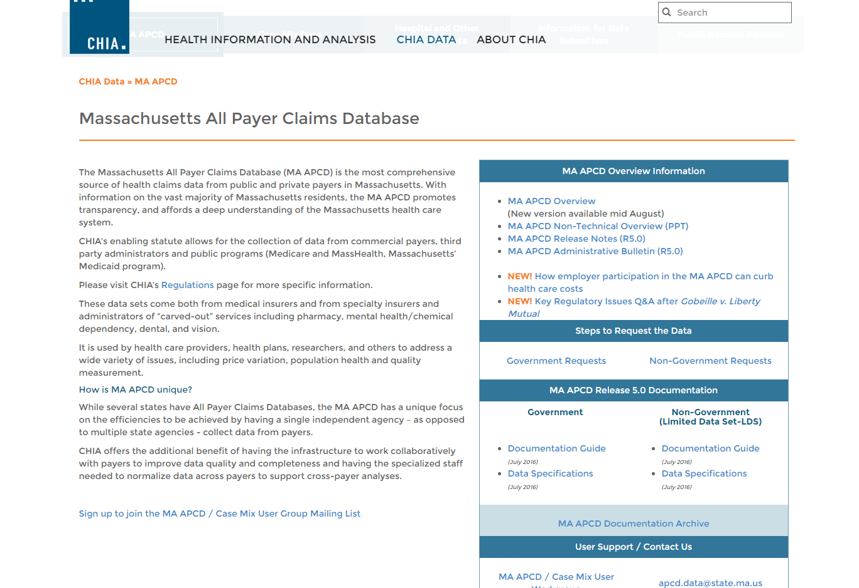
Release Documentation

Slide 5
MA APCD Release 5.0
Highlights of Release 5.0 Include:
Data is available for dates of service from January 1, 2011 to December 31, 2015 as paid through March 31, 2016.
Data submitted to CHIA after March 2016 is not included in the files
Comprehensive and recently updated data, including resubmissions from several large carriers
Versioning for additional carriers beyond those carriers from APCD Release 4.0 (Blue Cross Blue Shield of Massachusetts, Tufts Health Plan, Harvard Pilgrim, and MassHealth)

Slide 6
MA APCD Release 5.0
Additional Highlights of Release 5.0:
Government users may request both Level 2 and Level 3 elements, including MassHealth Enhanced Eligibility file and Benefit Plan file data
Non-Government users may request groups of Level 2 data elements, as curated by CHIA into Limited Data Sets (same as Release 4.0).
Some data elements have been derived by CHIA from submission data elements or have been added to the database to aid in versioning and identifying claims (e.g. Unique Record IDs and status flags).

Slide 7
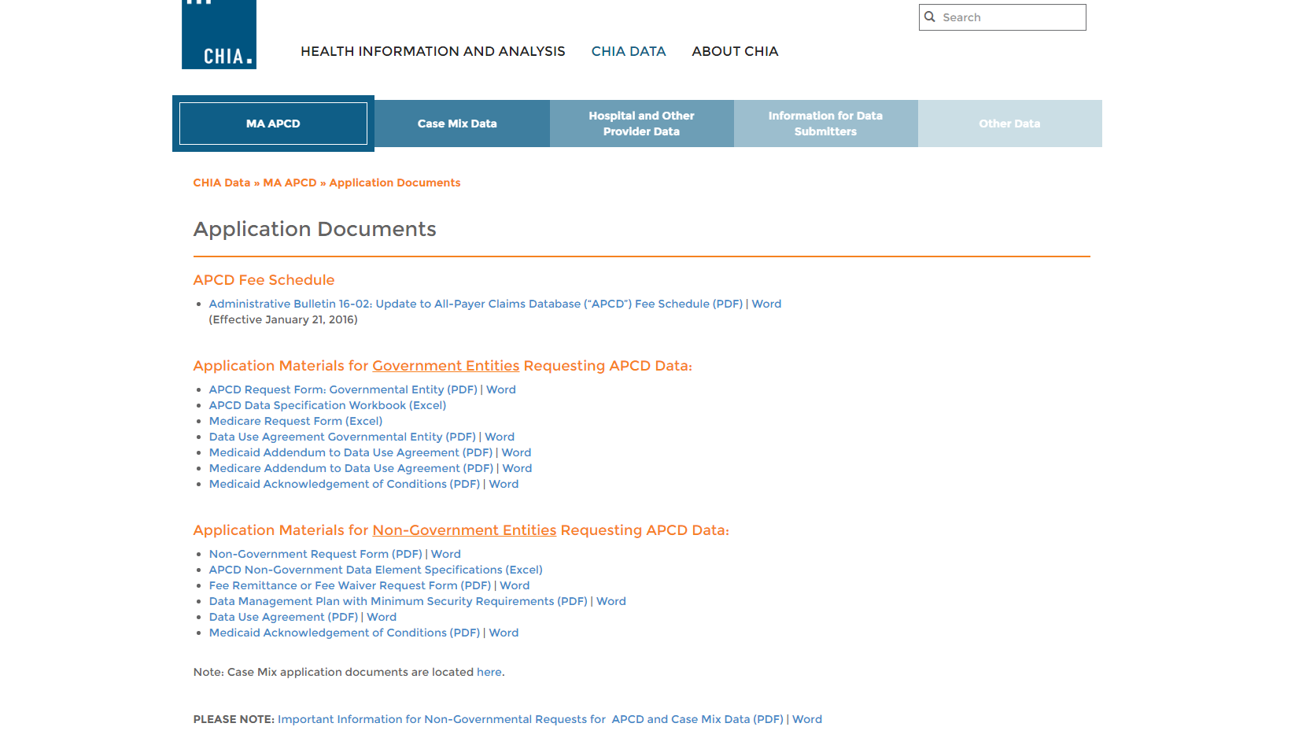
Revised Application Forms
Posted here: http://www.chiamass.gov/application-documents

Slide 8
Revised Data Management Plan
Posted here: http://www.chiamass.gov/assets/Uploads/data-apps/Data-Managment-Plan-for-Non-Government-Entities.docx

Slide 9
Case Mix FY15 Release
We are accepting applications for FY15 Case Mix data NOW
Inpatient Data is ready for release now
Emergency Department ready in late August
Outpatient Observation ready in September
Apply for all files now and we will fulfill them as they become available.
FY15 Case Mix data in LDS format
FY04-FY14 available in old “Levels” format (can request on the same application form)

Slide 10
QUESTIONS?

Slide 11
Application Reminders

Slide 12
Application Reminders
Don’t forget to upload CVs/Resumes for the “core project team” (even if you’ve previously been approved for data)
Don’t forget to upload IRB documentation (even if it’s been determined that you are not subject to IRB review)
If you’re uploading new/revised forms after your initial submission, don’t forget to re-lock your project so we know that new materials are ready for review

Slide 13
Differences Between APCD Release 4.0 and Release 5.0

Slide 14
What is the Difference between Release 4.0 and Release 5.0 in Medical Claims Volume?
Answer: Release 4.0 contains 1,735,249,048 Medical Claims and Release 5.0 contains 2,017,908,770 Medical Claims due to a complete submission year for 2015, partial year for 2016, and a few resubmissions for previous years.
1,295,444
Increase
181,580,470
Increase
5,109
Increase
99,778,699
Increase

Slide 15
What is the Difference between Release 4.0 and Release 5.0 in Pharmacy Claims Volume?
Answer: Release 4.0 contains 857,822,721 Pharmacy Claims and Release 5.0 contains 1,011,089,932 Pharmacy Claims due to a complete submission year for 2015, partial year for 2016, and a few resubmissions for previous years.
98,717,593
Increase
6,701
Decrease
701,095
Increase
53,855,224
Increase

Slide 16
Have the Number of MEIDs with Unknown Gender and Duplicate MEIDs with Different Genders changed from Release 4.0 to Release 5.0?
MA APCD Release 4.0
Total MEIDs
17,295,396
Percent Unknown Gender
10.5%
Percent Duplicate Gender
10%
MA APCD Release 5.0
Total MEIDs
17,367,223
Percent Unknown Gender
10.3%
Percent Duplicate Gender
9%

Slide 17
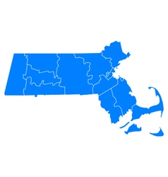
Has the Volume of MEIDs for Massachusetts Residents Changed by APCD Release?

Slide 18
Has the Volume of MEIDs for Massachusetts Residents Changed by APCD Release?
COUNTY | Release 3.0 | Release 4.0 | Release 5.0
Barnstable | 3.30% | 3.30% | 3.30%
Berkshire | 1.90% | 1.90% | 1.80%
Bristol | 7.70% | 7.70% | 7.70%
Dukes | 0.30% | 0.30% | 0.30%
Essex | 11.10% | 11.10% | 11.10%
Franklin | 1.10% | 1.10% | 1.10%
Hampden | 6.90% | 6.70% | 6.60%
Hampshire | 2.40% | 2.40% | 2.40%
Middlesex | 23.20% | 23.20% | 23.20%
Nantucket | 0.20% | 0.20% | 0.20%
Norfolk | 10.30% | 10.30% | 10.30%
Plymouth | 7.20% | 7.10% | 7.10%
Suffolk | 12.60% | 12.90% | 13.20%
Worcester | 11.50% | 11.40% | 11.40%
BLANK | 0.30% | 0.30% | 0.30%
 | 100.00% | 100.00% | 100.00%
Total | 10,436,467 | 10,867,971 | 10,650,715

Slide 19
Questions?
Questions related to APCD: (apcd.data@state.ma.us)
Questions related to Case Mix: (casemix.data@state.ma.us)
REMINDER: Please include your IRBNet ID#, if you currently have a project using CHIA data

Slide 20
Call for Topics and Presenters
If there is a TOPIC that you would like to see discussed at an MA APCD or Case Mix workgroup, contact Adam Tapply [adam.tapply@state.ma.us]
If you are interested in PRESENTING at an MA APCD or Case Mix workgroup, contact Adam Tapply [adam.tapply@state.ma.us]
You can present remotely from your own office, or in-person at CHIA.

