Slide 1
Apcd user workgroup
Adam Tapply (Manager of Accounts)
Sylvia Hobbs (Manager of User Support)
March 26, 2019
CENTER FOR HEALTH INFORMATION AND ANALYSIS

Slide 2
Agenda
Announcements:
  APCD Release 7.0
  Updates on FY17 Case Mix Release
  Timeline for FY18 Case Mix Release
Common Application Issues
User Support Questions
Q&A

Slide 3
MA APCD Release 7.0
  Available NOW
  Encompasses data from January 2013 – December 2017 with six months of claim runout (includes paid claims through 6/30/18)
  Release Documentation and Data Specifications have been posted to the website: http://www.chiamass.gov/ma-apcd/
  Apply now by listing 2017 (and any other years you want from Release 7.0) in the “Years Requested” section of the current application form
  Available here: http://www.chiamass.gov/application-documents

Slide 4
MA APCD Release 7.0 Highlights
  Contains ICD-10-CM procedure and diagnosis codes. ICD indicator flag indicates whether codes are reported in ICD-9 or ICD-10 format.
    NOTE: the ICD indicator flag is as reported by carriers and is not 100% accurate.
  Accountable Care Partnership Plans will be denoted starting in 2018 as follows:
    Insurance Type Code/Product (ME003, MC003, PC003, DC003) use the new value of 30 to denote ACO.
  A subset of MassHealth Enhanced Eligibility (MHEE LDS) data is now available to all approved recipients of MassHealth data for the first time. The MHEE LDS data provides a view of a member on any given day.

Slide 5
MA APCD Release 7.0 Highlights
  Updated Master Patient Index
    A small percentage of records may not have a MEMBERLINKEID due to inconsistencies and inaccuracies in carrier reporting. Please see the MA APCD Release 7.0 Master Patient Index (MPI) Data Exclusion document for a complete list.
    Created a MEMBERLINKEID crosswalk to enable users to apply Release 7.0 IDs to prior Release 6.0. This is available upon request.

Slide 6
Release 7.0 Carrier Highlights
  As a result of the Supreme Court Gobeille ruling, several carriers have removed some or all self-insured data from their MA APCD data submissions, resulting in a drop in members and claims in 2016 onward. At the end of 2017 reporting period, approximately 75% (or about 1.75 million members) of self-insured Member Eligibility data is missing from the MA APCD. Several carriers actively poll their employer groups for inclusion in MA APCD.
  Several small carriers have stopped submitting due to the Supreme Court Gobeille decision or have otherwise left the MA market. CHIA has retained their data for earlier years but users should note that data will be sporadic for the year they exited the MA APCD (consult the Release 7.0 Documentation Guide for full list of payers affected).

Slide 7
Release 7.0 Carrier Highlights
  Several carriers resubmitted data, improving data linkage between their file types.
  Three new submitters are included in Release 7.0.
  Additional carrier-specific highlights (by OrgID) can be found in the Release 7.0 Release Notes:
  http://www.chiamass.gov/assets/docs/p/apcd/apcd-7.0/MA-APCD-Release-7.0-Release-Notes.pdf

Slide 8
Case Mix FY17 Release
*CURRENT* RELEASE TIMEFRAMES FOR EACH FILE:
  Inpatient (HIDD)
  June [Completed]
  Emergency Department (ED)
  November [Completed]
  Outpatient Observation (OOD)
  February [Completed]

Slide 9
Case Mix FY18 Release
*CURRENT* RELEASE TIMEFRAMES FOR EACH FILE:
  Inpatient (HIDD)
  June
  Emergency Department (ED)
  August
  Outpatient Observation (OOD)
  September

Slide 10
Case Mix FY18 Release
REPEAT APPLICANTS:
  For those applicants with previously approved projects who indicated they would like to receive data annually, we began accepting Certificates of Continued Need and Compliance (Exhibit B of your DUA) starting on May 1st.
  After receiving this, we will send you an invoice for the FY18 data and release data to you once payment is received and the data is ready.
  If you are making any changes to your project, you must go through the amendment process first.

Slide 11
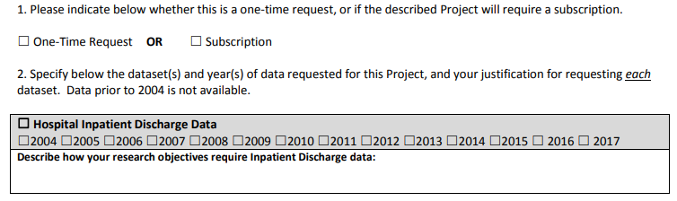
Case Mix FY18 Release
NEW APPLICANTS / NEW PROJECTS:
  We will continue to accept new applications on a rolling basis.
  If you are requesting FY18 data, just click the box for “Subscription” on p. 3 of the application form:

Slide 12
Application reminders

Slide 13
Top Application Reminders
  Answer EVERY question on the Application form and Data Management Plan.
  Remember to submit your Research Methodology or IRB Protocol (not just the IRB approval letter) (per Section IV in the Application form).
  Make sure your IRB approval is up-to-date. If it’s expiring soon, let us know of your plans to make sure it’s renewed.
  Submit Data Management Plans for any organization that will be storing CHIA data (including contractors).
  Provide as much information on proposed linkages as possible (per Section IX)
  Make sure your Application and Data Management Plan have the required signatures before submitting on IRBNet.
  If requesting a financial hardship waiver, make sure you submit supporting documentation.

Slide 14
USER questions

Slide 15
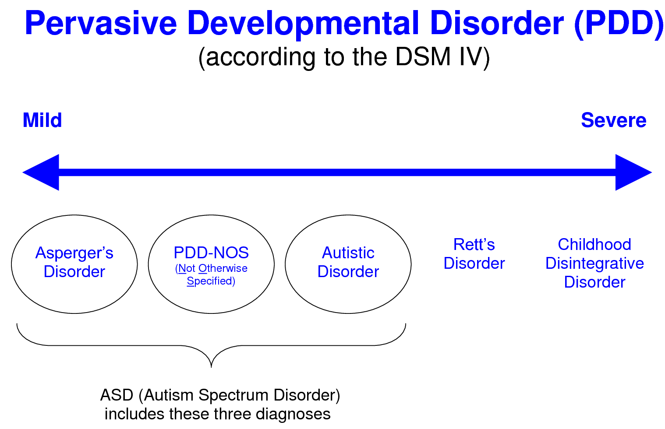
Question: We plan to use the MA APCD (Release 7.0) to track care transitions to adulthood for children with pervasive developmental disorders (PDD), including diagnoses on the autism spectrum, and we need to know the expected impact of Gobeille pediatric case finding.
Answer: In looking at monthly changes in trend for pediatric (< 22 years old) PDD cases over a 5-year period by payer type, from 2013 through December 2015, both commercial and Medicaid cases show the same upward trend until January 2016, when a significant drop in commercial payer cases occurs.
(Answered continued on next slide)
Medicaid,
12,697
2016 Commercial Downward Trend
Commercial,
7,952
Medicaid,
7,617
Commercial,
6,718

Slide 16
Answer (continued): Keep in mind that the 2016 drop in commercial PDD pediatric cases (see Fig. 1) also occurs in the overall commercial population regardless of diagnosis (see Fig. 2). Therefore, when overall commercial population base is used as a denominator to calculate the PDD rate per 1,000 (see Fig. 3), you can still detect an upward trend in the pediatric PDD rate from 2013 to 2017 in commercial population paralleling the Medicaid upward trend and that reported in medical literature suggesting that even with 2016 the decrease in commercial claims, the commercial data can still provide a meaningful study sample.
Figure 2. CY2013 to 2017 Distinct Count of all Massachusetts Pediatric Patients
Regardless of Diagnosis Comparison by Medicaid and Commercial Payer Type

Slide 17

Question: Our university is conducting different research projects using both MA APCD Release 5.0 and MA APCD Release 6.0. In both releases, we have found instances where the Member Link EID appears to be assigned to more than one person. Has this issue been resolved in Release 7.0?
Answer: The quality of data input into algorithm used to create the Member Link EIDs has improved. Therefore, as you can see in the Table below from Release 6.0 to Release 7.0, there has been a significant reduction in the combinations of conflicting information such as gender for a single Member Link EID in the Member Eligibility file.
Table 1. Comparison by MA APCD Release of Percent Type of Duplicates in Gender Field
MA APCD Release | Number of MEIDS | Male, Female, Unknown, Blank | Male, Female, Unknown | Male, Female
Release 5 | 15,709,422 | 0.01324% | 1.04% | 11.5%
Release 6 | 13,654,371 | 0.00803% | 0.80% | 9.7%
Release 7 | 13,065,848 | 0.00002% | 0.25% | 4.9%

Slide 18
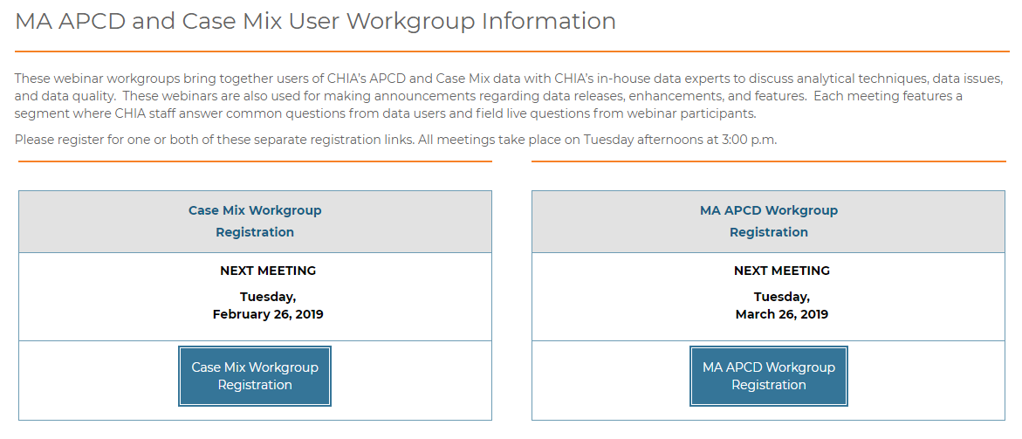
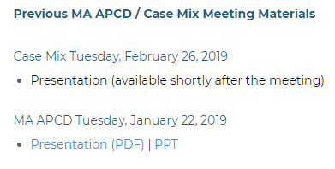
Where can I find old User Workgroup Presentations?
http://www.chiamass.gov/ma-apcd-and-case-mix-user-workgroup-information/

Slide 19
Questions?
Questions related to MA APCD:
apcd.data@state.ma.us
Questions related to Case Mix:
casemix.data@state.ma.us
REMINDER: Please include your IRBNet ID#, if you currently have a project using CHIA data.

Slide 20
Call for Topics and Presenters
If there is a TOPIC that you would like to see discussed at an MA APCD or Case Mix workgroup in 2019, contact Adam Tapply [adam.tapply@state.ma.us]
If you are interested in PRESENTING at an MA APCD or Case Mix workgroup in 2019, contact Adam Tapply [adam.tapply@state.ma.us]
You can present remotely, or in-person at CHIA.

