Slide 1
Apcd user workgroup
Adam Tapply (Manager of Accounts)
Sylvia Hobbs (Manager of User Support)
September 24, 2019
CENTER FOR HEALTH INFORMATION AND ANALYSIS

Slide 2
Agenda
Announcements:
  APCD Release 8.0 Updates
  FY18 Case Mix Release Updates
Future Website Updates
Application Reminders
User Support Questions
Q&A

Slide 3
MA APCD Release 7.0
  Available NOW
  Encompasses data from January 2013 – December 2017 with six months of claim runout (includes paid claims through 6/30/18)
  Release Documentation and Data Specifications have been posted to the website: http://www.chiamass.gov/ma-apcd/
  Apply now by listing 2017 (and any other years you want from Release 7.0) in the “Years Requested” section of the current application form
  Available here: http://www.chiamass.gov/application-documents

Slide 4
MA APCD Release 8.0
  Available Winter 2019/2020
  **Please hold off on submitting Release 8.0 requests for now**
  Will encompasses data from January 2014 – December 2018 with six months of claim runout (includes paid claims through 6/30/19)
  Will be linkable to Release 7.0 via crosswalk
  Additional information on highlights and enhancements will be presented in future APCD User Workgroups.

Slide 5

Case Mix FY18 Release
*CURRENT* RELEASE TIMEFRAMES FOR EACH FILE:
  Inpatient (HIDD)
  Mid-September [Shipping Now]
  Emergency Department (ED)
  Late September
  Outpatient Observation (OOD)
  Late September

Slide 6

COMING SOON: Website Release Updates
  Release updates on APCD and Case Mix data release will soon be on the CHIA website.
  Aiming to provide updates weekly or bi-weekly (more frequent updates closer to the release date)
  What kinds of information would users like to see?
    Current estimated release date?
    Where in the release “roadmap” is CHIA currently?
    How many data requests are currently in the fulfillment queue?
    Other information?

Slide 7
Application reminders

Slide 8
Fee Waiver Request Reminders
  If you’re submitting a request for a fee waiver, remember to include the fee remittance form in your application package on IRBNet.
  Remember to submit supporting documentation (if required).
  If you’re requesting a financial hardship waiver, remember to submit information detailing your project’s financial situation (examples: project budget, grant funding, organizational / departmental funding). Also request to pay a specific price that you reasonably believe you’re able to afford to contribute.
  CHIA generally does not offer full financial hardship fee waivers. We expect all applicants to have made an attempt to find funding to cover the full cost of the data fees.
  Fee waiver requests can take some time to process – especially financial hardship requests.

Slide 9
USER questions

Slide 10

Question: Did the downward shift in self-insured enrollees due to Gobeille v. Liberty Mutual have a higher impact on MA residents or non-MA residents in the MA APCD Release 7.0?
Self-Insured?
Answer: While the volume of MA residents in MA APCD remains higher than non-MA residents (see Fig. 1 below) , a distinct count of MEIDs in the Member Eligibility file stratified by MA residency and APCD ID Code enrollment categories reveals a larger proportional drop in in self-insured non-MA residents than self-insured MA residents (see Table 1 below).
Table 1. ME File Distribution of Distinct MEIDs by APCD ID Code Enrollee Category and MA Residency
Figure 1. Change in Annual Volume of Self-Insured Group Enrollee Distinct MEIDs by MA Residency
2,525,475
MA Residents
1,000,019
Non-MA Residents
1,096,704
203,166

Slide 11

Question: Did the downward shift in self-insured enrollees due to Gobeille vs. Liberty Mutual have a higher impact on any specific gender group?
GENDER
Answer: No, it did not. In evaluating the total volume of distinct MEIDS in the MA APCD Release 7.0 Member Eligibility file for all self-insured enrollees by gender regardless of state of residency (see Fig. 1 below), the percent drop for females from calendar year 2015 to calendar year 2016 was 68.1% vs 68.4% for males. State residency did not meaningfully impact the difference between males and females. For MA residents (see Fig. 2 below), the decrease was 56.9% for females vs. 57.7% for males. For non-MA residents (see Fig. 3 below), the decrease was 91.6% for females vs. 91.3% for males.
Fig 1. Distinct MEID Count for All Self-Insured Enrollees by Gender*
Fig 2. Count for MA Resident Self-Insured Enrollees by Gender*
Fig 3. Count for non-MA Resident Self-Insured Enrollees by Gender*
*Note: The gender category “Other” was not included due to self-insured enrollee volume < 11

Slide 12
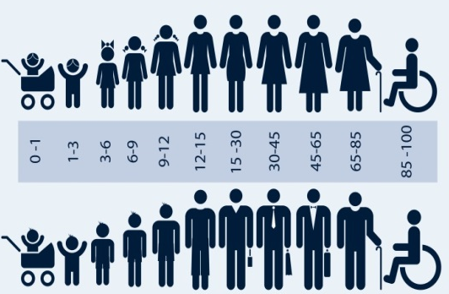
Question: Did the decrease in self-insured enrollees due to Gobeille
vs. Liberty Mutual have a higher impact on any specific age group?
AGE GROUPS
Answer: Yes, it did. In evaluating the total volume of distinct MEIDS in the MA APCD Release 7.0 Member Eligibility file for all self-insured enrollees by specific age group regardless of state of residency (see Table 1 below), the ages ranging from 28 to 47 years old had the highest decrease of 70% from calendar year 2015 to calendar year 2016 in comparison to other age groups. When limiting the self-insured enrollees to only Massachusetts residents (see Table 2 below) , the ages ranged from 28 to 47 years old still had the highest decrease of 59% from 2015 to 2016.
Table 1. Distinct MEID Count for All Self-Insured Enrollees by Age Group
Table 2. Distinct MEID Count for MA Resident Self-Insured Enrollees by Age Group

Slide 13

Question: The Case Mix Inpatient Hospital Discharge Data contains birth weight and the MA APCD does not. We are applying for the MA APCD and, as part of our study, plan on running the data through a DRG grouping software program where birth weight would allow more accurate information on the severity and risk of mortality for newborns. Can we link the MA APCD to Case Mix to obtain birth weight?
BIRTH WEIGHT
Answer: For your purposes, since the intent is to distinguish the severity and risk of mortality for those newborns who are not normal birth weight, both ICD-9-CM and ICD-10-CM contain diagnosis codes that provide different weight increments in grams (see Figure 1 below). CHIA evaluated the use of birth weight codes on newborns in the MA APCD Release 7.0 Medical Claims file to the weight of newborns provided in the Case Mix Inpatient Hospital Discharge Data and found that the newborn distribution weights reliably matched.
Less than 500 grams
500-749 grams
750-999 grams
1000-1249 grams
1250-1499 grams
1500-1749 grams
1750-1999 grams
2000-2499 grams
2500 grams and over
Fig. 1 - Newborn Weight Increments in grams contained in ICD-9-CM and ICD-10-CM diagnosis codes

Slide 14
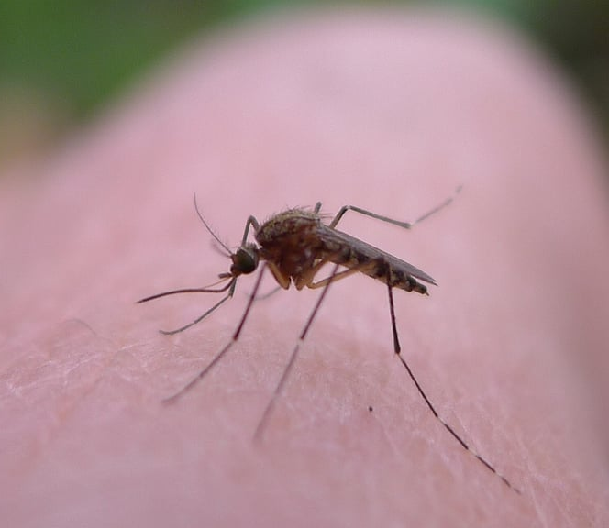
Question: We are preparing an application for the MA APCD to study the epidemiology of Emergency Department (ED) visits for insect bites and would like to know whether it is better to use the MA APCD for this study or the Case Mix Outpatient Emergency Department visit data?
Answer: If your study is limited to the ED visit alone without any evaluation of subsequent care coordination in other settings or reimbursement factors, then your best choice would be choice would be to apply for the Outpatient ED visit data, which contains all of the Medicare population and other payers (such as Worker’s Compensation) not included in the MA APCD LDS.
If your focus is limited to ED visits, the Case Mix Outpatient ED data is not impacted by Gobeille vs. Liberty Mutual and contains more consistently collected race and ethnicity data. While you do see a seasonal peak in ED visits for insect bites during the summer months (see Fig. 1 below), the downside of limiting your focus to the ED Visits would be the exclusion of the universe of insect bites seen and treated in the primary care setting which are available in the MA APCD.
Fig. 1 – Casemix Outpatient Emergency Department Jan 2016 through Sept 2017 Seasonal Visit Fluctuation for Insect Bites

Slide 15
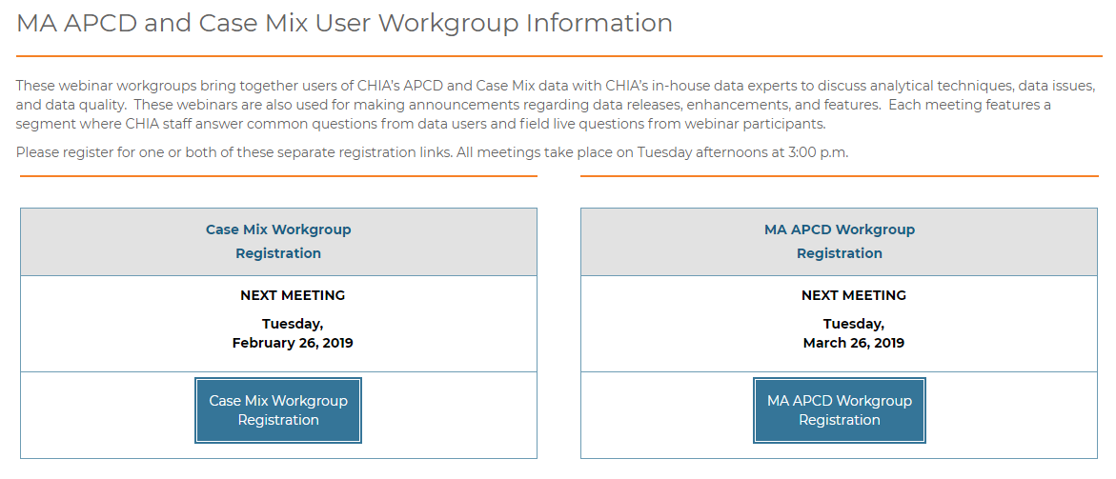
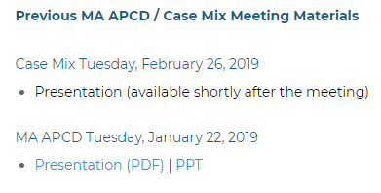
Where can I find old User Workgroup Presentations?
http://www.chiamass.gov/ma-apcd-and-case-mix-user-workgroup-information/

Slide 16
Questions?
Questions related to MA APCD:
apcd.data@state.ma.us
Questions related to Case Mix:
casemix.data@state.ma.us
REMINDER: Please include your IRBNet ID#, if you currently have a project using CHIA data.

Slide 17
Call for Topics and Presenters
If there is a TOPIC that you would like to see discussed at an MA APCD or Case Mix workgroup in 2019, contact Adam Tapply [adam.tapply@state.ma.us]
If you are interested in PRESENTING at an MA APCD or Case Mix workgroup in 2019, contact Adam Tapply [adam.tapply@state.ma.us]
You can present remotely, or in-person at CHIA.

