Slide 1
CHIA user workgroup
Don Kirkwood (Manager of Data Release and Procurement)
Sylvia Hobbs (Associate Director of Data Strategy and User Support)
December 5, 2023
CENTER FOR HEALTH INFORMATION AND ANALYSIS

Slide 2
Agenda
Announcements:
  APCD Release CY 2021 Updates
  FY22 Case Mix Release Updates
Website Updates
User Support Questions
  Mortality Data
  Suicide and Homicide Ideation
  Procedure Code Modifiers
  Gender Data Accuracy
  Medicaid HSN Indicator
  Type of Bill on Facility Claims (postponed to January webinar)
  Tracking Members in MA APCD (postponed to January webinar)
  Duplicate Records (postponed to January webinar)
Q&A

Slide 3
MA APCD CY 2021
  Available for request
  Applicants with approved projects that require updated APCD data (CY 2021 Data) should submit to CHIA a completed Exhibit B (Certificate of Continued Need and Compliance) of the Data Use Agreement. After submitting a completed Exhibit B you will receive an invoice (if applicable) for the requested data. Upon payment of the invoice the order for the data will be placed.
  CY 2021 Data includes medical, pharmacy, and dental claims incurred between January 1, 2019, and December 31, 2021, and it includes six (6) months of run-out (paid claims through June 30, 2022). In addition to claims data, the release contains relevant reference files including member eligibility, providers, products, and benefit plans.

Slide 4

Case Mix FY22 Release
*CURRENT* RELEASE TIMEFRAMES FOR EACH FILE:
  Inpatient (HIDD)
  Available for request
  Emergency Department (ED)
  Available for request
  Outpatient Observation (OOD)
  Available for request
  Applicants with approved projects using previous years data (e.g., FY 20, FY21) that require newly available year(s) of case mix data (e.g., FY 22) should submit to CHIA a completed Exhibit B (Certificate of Continued Need and Compliance) of the Data Use Agreement. After submitting a completed Exhibit B you will receive an invoice (if applicable) for the requested data. Upon payment of the invoice the order for the data will be placed.

Slide 5
Website Release Updates
  Updates on the production of MA APCD and case mix databases and status of data requests are now posted to CHIA’s website!
    Aim #1 is to provide weekly or bi-weekly status update on CHIA data products as they are in development.
    Aim #2 is to provide applicants with information about expected fulfillment status for individual data requests.
    Request IDs will be communicated to Data Requestors via email.
  Please visit http://www.chiamass.gov/status-of-data-requests/ to see the current status of data extracts and releases.
  You can also sign up to receive updates on the status of MA APCD and case mix data requests and data release information by filling out the form at the following link: https://lp.constantcontactpages.com/su/NYBm5Bs

Slide 6
USER questions

Slide 7

Question: I am using hospital discharge data to study inpatient mortality rates, but I also want to understand inpatient deaths of MA residents that occur in hospitals outside of MA. Are data available on inpatient deaths of MA residents occurring in hospitals outside of MA?
Mortality Data
Answer: Yes, the CDC’s Wide-Ranging Online Data for Epidemiologic Research search tool has Provisional Mortality Statistics, from 2018 through last week updated weekly available at the following website: https://wonder.cdc.gov/mcd-icd10-provisional.html This tool allows you to stratify deaths by state of residence, state of death occurrence, & place of death. The tables below show MA resident deaths through 11/18/2023. Totals are not available due to cell suppression.
Provisional Mortality Statistics for Massachusetts Residents, Year 2018 through Nov 18th, 2023
All Places of Death by State of Occurrence Inpatient Hospital Place of Death by State of Occurrence
Occurrence State | 2018 | 2019 | 2020 | 2021 | 2022 provisional | 2023 provisional and partial
MA | 57,640 | 57,057 | 66,522 | 61,278 | 61,536 | 51,079
RI | 519 | 576 | 624 | 611 | 576 | 509
NH | 217 | 227 | 254 | 281 | 262 | 209
FL | 232 | 204 | 259 | 236 | 240 | 195
CT | 113 | 114 | 115 | 171 | 194 | 177
NY | 70 | 78 | 87 | 113 | 102 | 102
ME | 72 | 67 | 65 | 81 | 85 | 54
VT | 24 | 30 | 40 | 40 | 42 | 40
CA | 27 | 47 | 23 | 37 | 41 | 21
NJ | 12 | 25 | 26 | 25 | 33 | 19
PA | 27 | 19 | 17 | 25 | 28 | 18
NC | 18 | 21 | 19 | 25 | 27 | 14
TX | 12 | 19 | 19 | 19 | 20 | 22
VA | 16 | 15 | 27 | 19 | 23 | *
SC | 13 | * | 15 | 24 | 23 | 13
GA | 16 | * | 23 | 13 | 12 | 13
MD | 15 | 12 | 14 | 11 | 18 | *
AZ | 16 | 12 | * | 12 | 13 | *
OH | 11 | * | * | 12 | * | 11
IL | * | 11 | * | * | * | *
CO | * | 12 | * | * | * | *
Occurrence State | 2018 | 2019 | 2020 | 2021 | 2022 provisional | 2023 provisional and partial
MA | 16,581 | 16,516 | 20,596 | 19,991 | 19,834 | 16,315
RI | 224 | 231 | 224 | 210 | 218 | 200
NH | 66 | 76 | 87 | 106 | 90 | 76
FL | 84 | 58 | 73 | 95 | 84 | 58
CT | 42 | 43 | 45 | 85 | 105 | 110
NY | 37 | 40 | 39 | 51 | 41 | 50
ME | 14 | 13 | 16 | 24 | * | 11
VT | * | * | * | 12 | * | *
PA | * | * | * | 15 | * | *
CA | * | 15 | * | * | * | *
VA | * | * | 12 | * | * | *
SC | * | * | * | 12 | * | *
TX | * | * | * | * | * | 11
NJ | * | * | * | * | 11 | *
Source: Centers for Disease Control and Prevention, National Center for Health Statistics. National Vital Statistics System, Provisional Mortality on CDC WONDER Online Database. Data are from the final Multiple Cause of Death Files, 2018-2021, and from provisional data for years 2022-2023, as compiled from data provided by the 57 vital statistics jurisdictions through the Vital Statistics Cooperative Program. Accessed at http://wonder.cdc.gov/mcd-icd10-provisional.html on Nov 29, 2023.

Slide 8
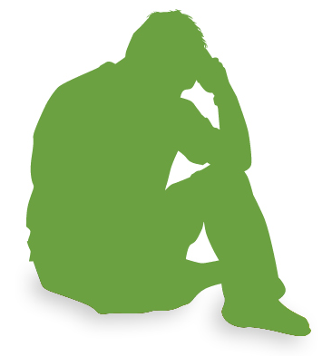
Question: We have been using the FY2016 through FY2021 outpatient hospital emergency department (ED) data to analyze behavioral health and noticed an increase in ED visits with a primary diagnosis of violent behavior, suicide and homicide ideation. We wanted to determine whether the increase continued in FY2022. If so, we are also considering applying for both the FY2022 ED data and the MA APCD. If we apply for the MA APCD, what other types of potential care settings would be available to study suicide and homicide ideation in the MA APCD?
Suicide and
Homicide Ideation
Answer: The FY2022 case mix ED visit does show an increase in visits with a primary diagnosis of suicidal ideation (ICD-10-CM R45851), homicidal ideation (ICD-10-CM R45850) and violet behavior (ICD-10-CM R456). See figures 1, 2, and 3 below. In the MA APCD, the volume of patients with a primary diagnosis of suicidal ideation, homicidal ideation or violent behavior exceeds the case mix data due to the magnitude of care settings. While general acute care hospital setting is the top MA APCD care setting for such cases, other top care settings include medical specialty and multi-specialty clinics, ambulance services (both ground and air), community health centers, psychiatric hospitals, single specialty clinics, emergency care clinics, community behavioral health agencies, pediatric hospitals, critical access hospitals, outpatient rehabilitation facilities, and long- term care hospitals.
FY2018 through FY2022 ED Visits with Primary Diagnosis of Suicide Ideation, Homicide Ideation and Violent Behavior

Slide 9

Question: I am applying for the MA APCD to study access to care focusing on the surge in the use of telehealth. However, part of my study also includes determining to what extent medical care is in part provided by medical residents. In the MA APCD medical claims, is there a flag field or any way of determining whether the medical care was provided by a medical resident?
Medical Residents
Answer: Yes, the CPT procedure code modifier ‘GC’ indicates whether the service(s) billed for were performed in part by a medical resident under the direction of a teaching physician. The MA APCD contains four(4) procedure code modifier fields. The MA APCD also contains a taxonomy code for the service provider specialty field. When ranking medical claims with a ‘GC’ modifier by the teaching physician’s taxonomy, the top-ranking specialties were internal medicine and diagnostic radiology (see Table 1 below). Following the onset of the CY2020 pandemic, there was an increase in medical claim lines with ‘GC’ code modifiers. From CY2020 to CY2021, there was an 18% increase in the highest version paid amount for such claims (see Figure 1 below) and a 16% increase in the charge amount (see Figure 2 below).
Table 1. Top Ten Physician Specialties Overseeing
Services Provided by Medical Residents
Figure 1. Highest Version Paid Amount for Medical Claim Lines with Services by Medical Residents
Rank | Service Provider Specialty
1 | Internal Medicine Physician
2 | Diagnostic Radiology Physician
3 | Single Specialty Group
4 | Anesthesiology Physician
5 | Emergency Medicine Physician
6 | General Practice Physician
7 | Cardiovascular Disease Physician
8 | Surgery Physician
9 | Family Medicine Physician
10 | Dermatology Physician
Figure 2. Charge Amount for Medical Claim Lines with Services by Medical Residents

Slide 10

Question: I am currently applying for the MA APCD to study gender reassignment medical care. Has CHIA examined data consistency in reporting practices with regards to changing or maintaining patient gender in member eligibility data before and after intersex change surgical procedures and determined to what extent intersex procedures explain unique identifiers associated with more than one gender?
Gender Data Accuracy
Answer: Yes, earlier as part of data quality review of MA APCD Release 8.0, we measured the consistency in the format and value of certain data elements to ensure referential integrity and semantic integrity of analytic results, specifically whether the data were describing the intended member entity. While the numbers were small, each year, less than 1% of unique patient identifiers are associated with more than one gender. While little has been published on the processes for addressing legitimate changes in the gender field that do not constitute a data quality error but are instead intentional changes following gender reassignment surgical interventions, we analyzed three procedure codes for intersex surgery (CPT 55970, CPT 55980, and CPT 57335). Carrier specific unique member identifiers and member link entity identifiers were used to quantify the magnitude of gender reporting changes in the medical claims data and in the eligibility data before and after the date of intersex surgery in the medical claims data to better understand current data reporting practices. A change in gender reporting occurred for 40% of beneficiaries on subsequent medical claims following intersex surgery and in 44% of eligibility records, with 39% of beneficiaries having an alignment between a change in gender on their medical claims with a change in gender on eligibility data. Eligibility records in an additional 7% of the cases resorted temporarily coding gender as unknown.
Also, please note that in February 2023, CHIA updated its gender coding options in the MA APCD filing specifications. See Table 1 below.
Table 1. February 2023 Update in Gender Codes in MA APCD
Code | Description
F | Female
M | Male
A | Transgender Male/Trans Man
B | Transgender Female/Trans Woman
G | Genderqueer/gender nonconforming: neither exclusively male nor female
N | Non-binary
O | Other
U | Unknown
C | Choose not to answer

Slide 11
Question: When we queried the MA APCD medical claims by orgid stratified by Medicaid/HSN indicator to study the MassHealth population, it was not clear why the volume of medical claim lines with the Medicaid indicator value of ‘true’ exceeded the
total volume of medical claim lines for the MassHealth orgid.
MEDICAID
HSN
INDICATOR
Answer: The Medicaid/HSN indicator is not limited to MassHealth (OrgID 3156), but also includes Health Safety Net (OrgID 11541), and 17 other carriers with Medicaid products such as MassHealth Accountable Care Organizations and Medicaid Managed Care Organizations. If you stratify the medical claims data by insurance type code product and count the volume of claim lines with a Medicaid/HSN indicator value of ‘true’, you can see the proportion of other products with the value of ‘true’ for the Medicaid/HSN indicator. See Figure 1 below.
Fig 1. MA APCD Release 10 Percent of Eligibility Records with Medicaid/HSN Indicator of ‘True’

Slide 12
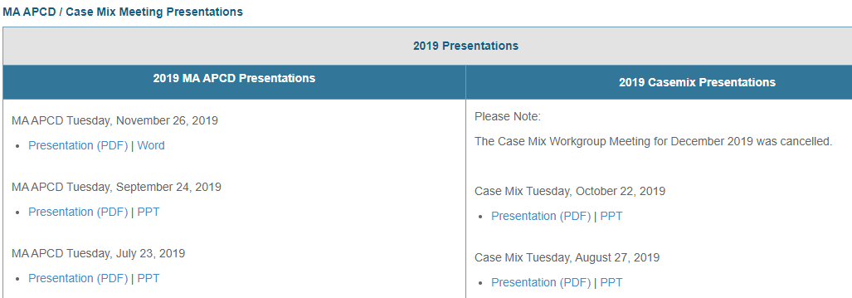
Where can I find past User Workgroup Presentations?
http://www.chiamass.gov/ma-apcd-and-case-mix-user-workgroup-information/

Slide 13
When is the next User Group meeting?
The next User Group will meet Tuesday January 23, 2024.
http://www.chiamass.gov/ma-apcd-and-case-mix-user-workgroup-information/

Slide 14
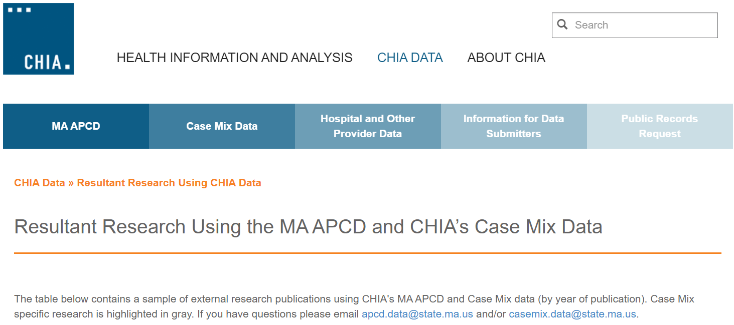
Resultant Research Using CHIA Data
https://www.chiamass.gov/resultant-research-using-chia-data

Slide 15
Questions?
Questions related to MA APCD:
apcd.data@chiamass.gov
Questions related to Case Mix:
casemix.data@chiamass.gov
REMINDER: Please include your IRBNet ID#, if you currently have a project using CHIA data.

