Slide 1
CHIA user workgroup
Don Kirkwood (Manager of Data Release and Procurement)
Sylvia Hobbs (Manager of User Support)
Scott Curley (Manager Privacy & Compliance)
November 23, 2021
CENTER FOR HEALTH INFORMATION AND ANALYSIS

Slide 2
Agenda
Announcements:
  APCD Release 10.0 Updates
  FY20 Case Mix Release Projections
  Data Release and Application Update
Website Updates
Application Reminders
User Support Questions
  Provider Geography
  Discharge Date
  Midwives
Q&A

Slide 3
MA APCD Release 10.0
  Available for request
  Applicants with approved projects that require updated APCD data (Release 10.0) should submit to CHIA a completed Exhibit B (Certificate of Continued Need and Compliance) of the Data Use Agreement. After submitting a completed Exhibit B you will receive an invoice (if applicable) for the requested data. Upon payment of the invoice the order for the data will be placed.
  Release 10.0 includes data on services from January 2016 – December 2020 with six months of claim runout.

Slide 4

Case Mix FY20 Release
*CURRENT* RELEASE TIMEFRAMES FOR EACH FILE:
  Inpatient (HIDD)
  Available for request
  Emergency Department (ED)
  Available for request
  Outpatient Observation (OOD)
  Available for request
  Applicants with approved projects that require newly available year(s) of Case Mix Data (e.g., FY 19) should submit to CHIA a completed Exhibit B (Certificate of Continued Need and Compliance) of the Data Use Agreement. After submitting a completed Exhibit B you will receive an invoice (if applicable) for the requested data. Upon payment of the invoice the order for the data will be placed.

Slide 5
Data Release and Application Updates
Due to Governor Baker’s emergency actions to limit the spread of COVID-19 CHIA’s workforce will be remote, for now. This arrangement will limit CHIA’s ability to produce and deliver data extracts. At this time, CHIA is releasing data and providing extracts to requestors.
During this time, CHIA will continue to accept and review data applications for both Case Mix and All-Payer Claims Database (MA APCD) datasets. Review committees, DRC and DPC, will continue their meetings remotely as necessary.
Due to CHIA’s physical office being closed, applications will be accepted without a fee. After receipt of the application, CHIA will issue an invoice which will allow applicants to remit payment online.
If you are a Data User that has a CHIA hard drive in your possession, please keep the hard drive at this time while CHIA’s physical office is closed.

Slide 6
Website Release Updates
  Updates on the production of APCD and Case Mix databases and status of data requests are now posted to CHIA’s website!
    Aim #1 is to provide weekly or bi-weekly status update on CHIA data products as they are in development.
    Aim #2 is to provide applicants with information about expected fulfillment status for individual data requests.
    Request IDs will be communicated to Data Requestors via email.
  Please visit http://www.chiamass.gov/status-of-data-requests/ to see the current status of releases.

Slide 7
Application reminders

Slide 8
Fee Waiver Request Reminders
  If you’re submitting a request for a fee waiver, remember to include the fee remittance form in your application package on IRBNet.
  Remember to submit supporting documentation (if required).
  If you’re requesting a financial hardship waiver, remember to submit information detailing your project’s financial situation (examples: project budget, grant funding, organizational / departmental funding). Also request to pay a specific price that you reasonably believe you’re able to afford to contribute.
  CHIA generally does not offer full financial hardship fee waivers. We expect all applicants to have made an attempt to find funding to cover the full cost of the data fees.
  Fee waiver requests can take some time to process – especially financial hardship requests.

Slide 9
USER questions

Slide 10

Provider
Geography
Question: We reviewed the medical claims and provider APCD
filing specifications to determine the data elements needed to
link the provider to the geographic location where care was
rendered. The data elements did not align with our expectations
based on the definitions.
Medical Claims
365 outpatient medical claim lines for 118 different patients
Medical Claims
Provider Entity (Person) with 64 different service provider names
Medical Claims
An identical provider location, plan rendering, and service provider linkage ID for all 64 provider names and all medical claim lines
Provider Table
Provider table 11,615 records with identical linkage ids and NPIs but 22 distinct ZIPs indistinguishable for the 64 providers
Answer: The medical claims filing specifications explain that MC134 Plan Rendering Provider and MC135 Provider Location should describe precisely who performed the services on the patient and where the service was rendered. However, there are instances where the providerlocation_linkage_id is either missing or, if available, links to multiple geographic locations in the provider table associated with the same providerlocation_linkage_id as depicted In the example below.
The provider table had 11,615 records with the same linking provider ID and National Provider ID, but 22 distinct Massachusetts ZIP codes indistinguishable by the 64 service providers named in medical claims. When this occurs, one workaround is to determine whether at the medical claim line level each of service provider names have a unique National Service Provider ID. In this instance they did. When their medical claim line National Service Provider IDs were linked to the CMS NPI Registry, 23 distinct Massachusetts ZIP codes were associated with their primary practice location which, except for one, aligned with 22 ZIP codes in the provider table. Therefore, checking the primary practice location in the CMS NPI Registry associated with the medical claim line level service provider NPI can be a workaround for this geographic anomaly.
MA APCD Medical Claims
National Service Provider ID link to CMS NPI Registry
CMS NPI Registry
Obtain Primary Practice Location
MA APCD Provider Table
CMS Primary Practice location can be used to differentiate multiple ZIP codes associated with the same provider ID in the provider table

Slide 11

Question: During the September webinar on discharge date, 95% of the missing discharge dates were attributed to patients with a patient discharge status code ‘30’ which, according to CMS, indicated the claim line was interim billing for someone who is still a patient such as those in nursing home and long-term care facilities. How does one distinguish the time periods when such patients are hospitalized?
DISCHARGE DATE
Answer: The MA APCD medical claims has occurrence span code fields (see description
below) and occurrence span code date fields to designate periods qualifying as
hospitalization. The use of these codes are described in detail on the CMS medical learning network website.
Code | Occurrence Span Code Description
70 | Qualifying Stay Dates - SNF TOB 3-day hospital stay qualifying stay dates for SNF use only.
70 | Nonutilization Dates - PPS inlier (free days) stay for which the beneficiary has exhausted all regular days and/or coinsurance days, but which is covered on the cost report.
71 | Hospital Prior Stay Dates - (Part A Claims Only) From/Through dates given by the patient of any hospital stay that ended within 60 days of this hospital or SNF admission.
72 | First/Last Visit - This code and corresponding dates indicate the actual dates of the first and last outpatient services visit. Note: This code is used for outpatient bills only when the actual from and through service dates shown in FL 6, statement covers period, do not represent the entire billing record. The dates should reflect the first and last time the patient was seen or treated within the FL 6 billing period. Repetitive services and related services should be submitted to Medicare on one monthly bill. When providers bill the entire month, use occurrence span code 72 to reflect the first and last visit dates.
74 | Noncovered Level of Care - From/through dates of a period at a non-covered level of care or leave of absence in an otherwise covered stay. Also used for Part B repetitive services to show a period of inpatient hospital care or outpatient surgery during the billing period.
75 | SNF Level of Care - From/through dates of a period at a non-covered level of care during an inpatient hospital stay - only used when SNF bed is not available.
76 | Patient Liability-From/through dates of a period of non-covered care for which the hospital/ SNF is permitted to charge the Medicare beneficiary.
77 | Provider Liability-Utilization Charged - The from/through dates of a period of non-covered care for which the provider is liable
78 | SNF Prior Stay Dates - From/through dates given by the patient of any SNF or nursing home stay that ended within 60 days of this hospital/SNF admission
M0 | QIO/UR stay dates - if a code "C3" is in FL 24-30, the provider enters the From and Through dates of the approved billing period.
M1 | Provider liability - no utilization - code indicating From/Through dates of noncovered care denied for lack of medical necessity. Provider may not collect Part A or Part B deductible or coinsurance from the beneficiary.
M2 | Dates of Inpatient Respite Care for hospice patients
M3 | ICF Level of Care - From/through dates of a period of intermediate level of care during an inpatient hospital stay
M4 | Residential Level of Care - From/through dates of period of residential level of care during an inpatient stay
MR | Reserved for Disaster related code

Slide 12

Question: We are interested in looking at outpatient births occurring at home and in birthing centers overseen by midwives? Does the MA APCD contain data on midwives and birthing centers?
MIDWIVES
Answer: Yes, the MA APCD has data on over 10,000 midwives practicing in
all 50 states including Washington, DC, with the highest volume of data
from midwives in Massachusetts, followed by New Hampshire, Connecticut,
and New York and less than 100 doulas. Three taxonomy codes are used to
determine if the medical care provider is a midwife or doula.
The MA APCD also contains data on 118 birth centers located. Please note that births can occur in other outpatient community health centers, clinics and even in ambulances. However, for an outpatient birth center which is a health care facility for childbirth typically staffed by midwives, doulas, and other obstetrics specialists, one taxonomy code can be used.
TAXONOMY | DESCRIPTION
176B00000X | Midwife
367A00000X | Advanced Practice Midwife
374J00000X | Doula
TAXONOMY | DESCRIPTION
261QB0400X | Birthing Center

Slide 13


Question: A CHIA white paper explains that although more than 80 payers
submit data to the MA APCD, MassHealth and 15 private payers (Blue
Cross Blue Shield of MA, Tufts Health Plan, Harvard Pilgrim,
Anthem/UniCare, Boston Medical Center HealthNet, Neighborhood Health
Plan, Fallon Community Health/ Fallon Health and Life, Health Plans Inc ,
Network Health, Aetna, CIGNA, Health New England, United Health
Care, ConnectiCare of MA, and Celticare) submit 95% of the data.
These carriers were dumbed the “Sweet Sixteen”. Has the “Sweet Sixteen” changed post-Gobeille?
Answer: In comparing the annual volume of pre-Gobeille highest version and unversioned medical claims data volume to post-Gobeille calendar year 2017 medical claims by payer, yes, there has been some shifting in the highest volume of claims by payer. Prior to Gobeille, the highest volume of medical claims were received from a commercial private payer. Post Gobeille, the highest volume of claims are received from a public payer.
Post-Gobeille Sweet 16
MassHealth/Massachusetts Behavioral Health Partnership
Blue Cross Blue Shield of Massachusetts
Tufts Health Plan
Harvard Pilgrim Health Care
Neighborhood Health Plan
Network Health
United Healthcare
WellPoint
Boston Medical Center HealthNet Plan
Health New England, Inc.
Fallon
Commonwealth Care Alliance
Beacon Health Strategies
Health Safety Net
First American Administrators
Senior Whole Health

Slide 14
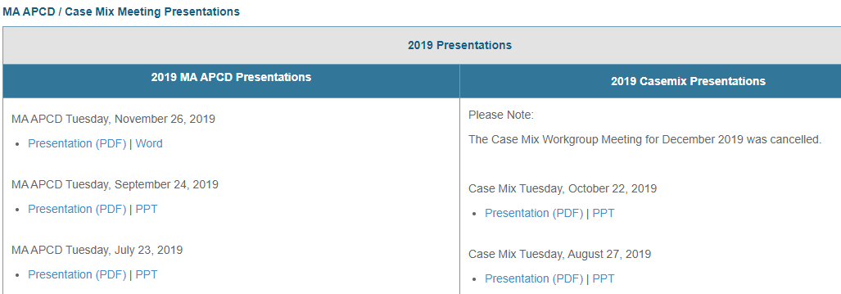
Where can I find past User Workgroup Presentations?
http://www.chiamass.gov/ma-apcd-and-case-mix-user-workgroup-information/

Slide 15
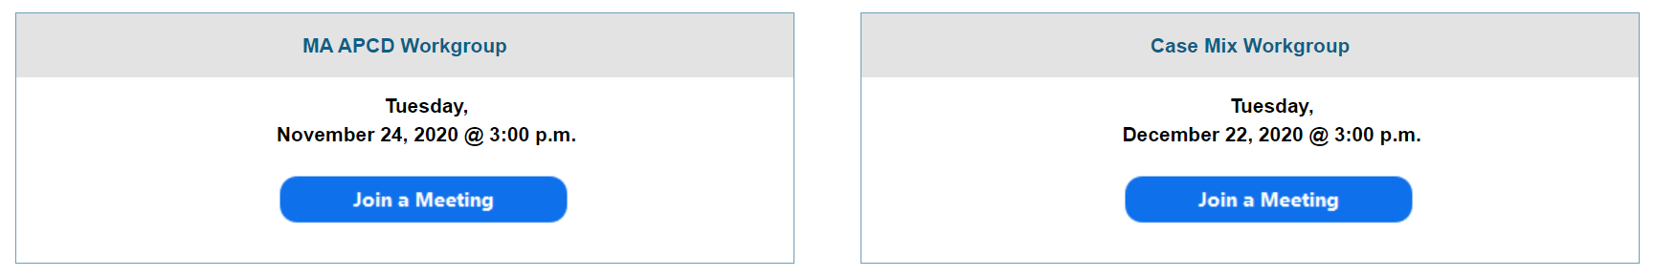
When is the next User Group meeting?
The next User Group will meet Tuesday, January 25.
http://www.chiamass.gov/ma-apcd-and-case-mix-user-workgroup-information/

Slide 16
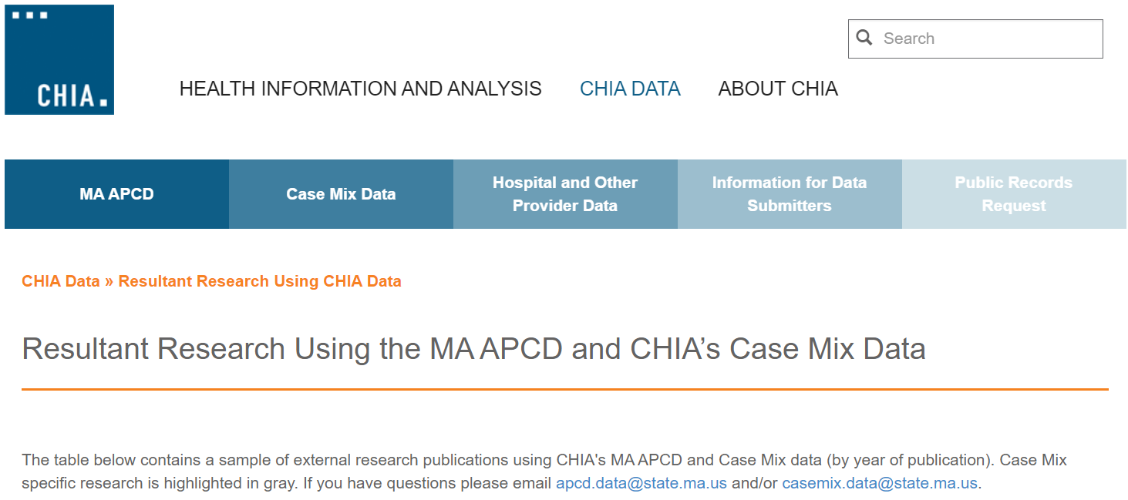
Resultant Research Using CHIA Data
https://www.chiamass.gov/resultant-research-using-chia-data

Slide 17
Questions?
Questions related to MA APCD:
apcd.data@chiamass.gov
Questions related to Case Mix:
casemix.data@chiamass.gov
REMINDER: Please include your IRBNet ID#, if you currently have a project using CHIA data.

Slide 18
Call for Topics and Presenters
If there is a TOPIC that you would like to see discussed at an MA APCD or Case Mix workgroup in 2021, contact Amy Wyeth [amy.wyeth@chiamass.gov]
If you are interested in PRESENTING at a MA APCD or Case Mix workgroup in 2021, contact Amy Wyeth [amy.wyeth@chiamass.gov]
You can present remotely, or in-person at CHIA
We may be reaching out to some data users with invitations to present, and hope you will consider this!

