Slide 1
CHIA Data User Workgroup
Donald Kirkwood, Manager of Data Release and Procurement
Scott Curley, Chief Data Product Officer
Anne Medinus, Senior Research Account Specialist
Sylvia Hobbs, Associate Director of Data Strategy and User Support
February 25, 2025

Slide 2
Agenda
Announcements:
  FY2023 Case Mix Releases, Documentation and Release Notes
  Certificate of Continued Need and Compliance
  CHIA’s YouTube Video Training on Data Use Obligations
  New - MA APCD CY2023 Now Available for Request
  New England Journal of Medicine Launches new journal NEJM AI
Data User Support Questions
  CPT and HCPCS codes for AI-enabled medical devices and diagnostic services
  Member Link EIDs for Behavioral Health Care Transitions
  Payer Source Code for Medicare HMO Products
Q&A

Slide 3
Announcements

Slide 4
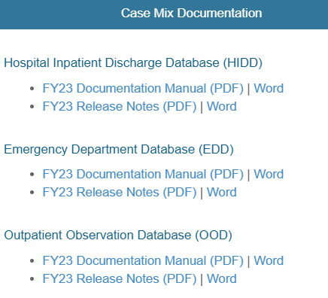
FY2023 Case Mix Releases and Documentation
ALL FY2023 CASE MIX RELEASES ARE AVAILABLE
  Hospital Inpatient Discharge Data FY2023 (HIDD)
  Outpatient Emergency Department Visit Data FY2023 (EDD)
  Outpatient Observation Stay Data FY2023(OSD)
Documentation and Release notes available at
https://chiamass.gov/case-mix-data
CASE MIX DOCUMENTATION AND RELEASE NOTES
Before accessing the FY2023, review the case mix documentation and release notes. The documentation contains a data overview, including data element list, data dictionary, reference tables, and summary statistics. The release notes contain information directly submitted by hospitals explaining data anomalies. Remember to review documentation and release notes before accessing data.

Slide 5
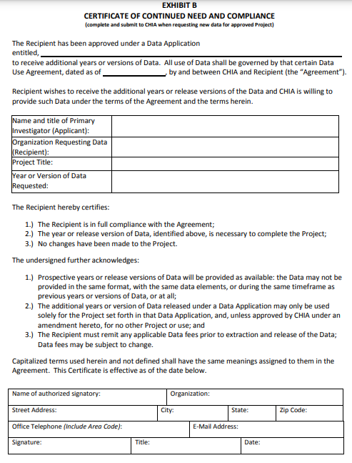
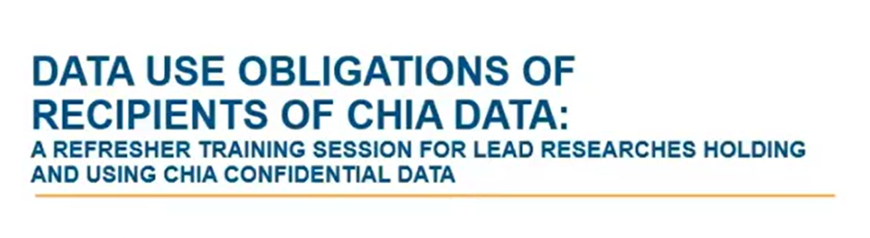
CERTIFICATE OF CONTINUED NEED AND COMPLIANCE
Exhibit B (Page 10 of the DUA)
Those with approved projects using previous data who a new year’s data should submit an Exhibit B (Certificate of Continued Need and Compliance) of page 10 the Data Use Agreement. Afterwards, you will receive an invoice (if applicable). Upon payment, the order for the new year of data will be placed.
CHIA’s YouTube Channel Video
Data users should review CHIA’s short 12-minute YouTube video by CHIA’s Legal Unit on the Data Use Obligations of Recipients of CHIA Data: A Refresher Training Session for Lead Researchers Holding and Using CHIA Confidential Data at: https://www.youtube.com/watch?v=Zr0GTm9PBXg

Slide 6

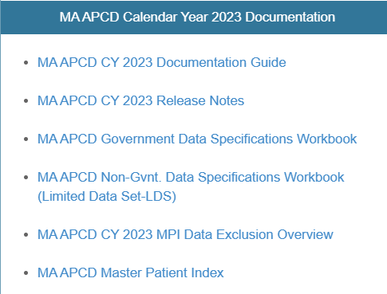
MA APCD CY2023 Now Available
CY2023 MA APCD is now available and includes medical, pharmacy and dental claims incurred between January 1, 2019, and December 31, 2023. It includes a six months of run-out (paid claims through June 30, 2024). In addition to claims data, the release includes associated member eligibility, providers, products, and benefit plans. Applicants already approved for MA APCD CY2022 who require CY2023 should submit to CHIA a completed Exhibit B (Certificate of Continued Need and Compliance) of the DUA. Afterwards, you will receive an invoice (if applicable) for the requested data. Upon payment of the invoice the order for the data will be placed. As with case mix data, before accessing the MA APCD remember to review documentation on the releases available at: https://www.chiamass.gov/ma-apcd/
Documentation and Release notes available at
https://chiamass.gov/ma-apcd
Before accessing the CY2023 MA APCD, review the documentation guide and release notes for important highlights and updates to the data. For example, in this release, CHIA’s substance use disorder filter was updated to include fourteen new codes within the ranges in the 2018 CMS SUD filter.

Slide 7

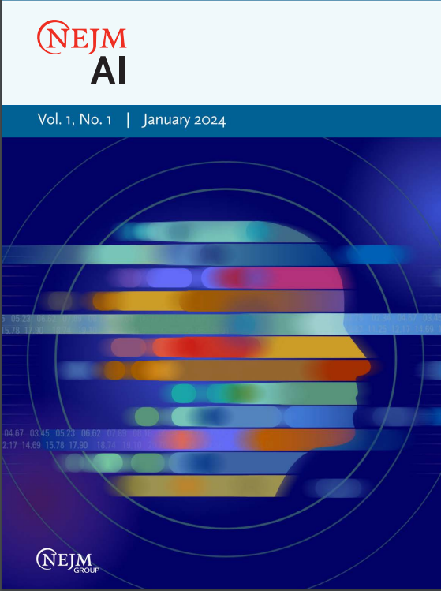
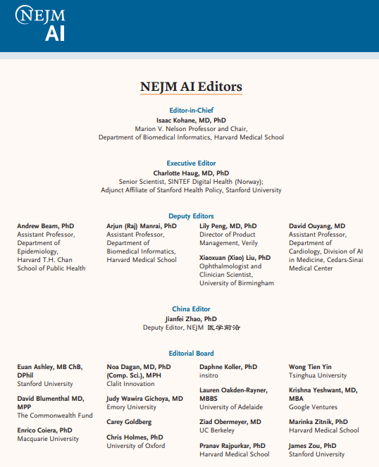
Alert: Massachusetts Medical Society’s NEJM Launches New Artificial Intelligence Journal
NEJM AI
NEJM AI, a new monthly journal from New England Journal of Medicine Group of the Massachusetts Medical Society, explores AI and machine learning in clinical medicine. It fosters interdisciplinary dialogue, pairing pre-clinical and clinical articles to provide critical context for both clinicians and researchers.
The journal covers AI applications in biomed informatics, telemedicine, medical imaging, personalized medicine, and policy. It adheres to NEJM’s rigorous peer-review standards and publishes original research, datasets, case studies, reviews, perspectives, policy discussions, and editorials. NEJM AI bridges technological advancements with clinical practice, addressing ethical, regulatory, and implementation challenges in medical AI.
The first issue is downloadable for free at:
https://ai.nejm.org/toc/ai/1/1

Slide 8
Data User Support Questions

Slide 9
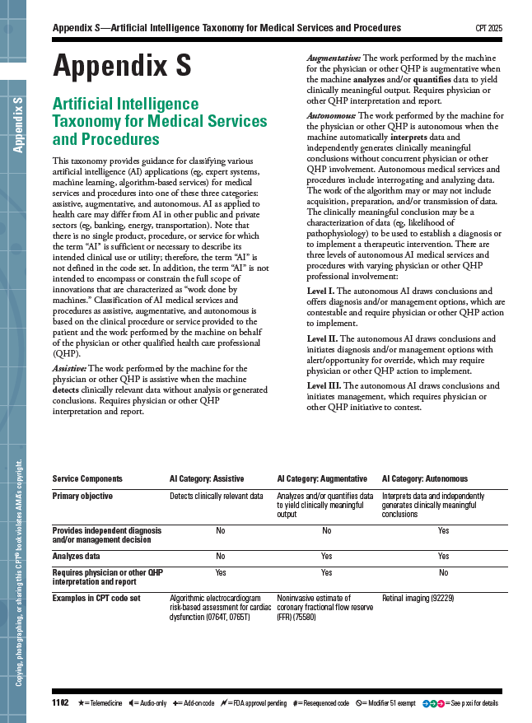
Question: Where are the most comprehensive sources of information on the implementation of CPT and HCPCS codes for AI-enabled medical devices and diagnostic services for healthcare billing? And, to what degree do current datasets reflect the utilization of these codes in clinical and administrative settings?
Answer: The American Medical Association (AMA) is responsible for creating, maintaining, and updating the CPT code set, including AI-related CPT codes. In 2021, the AMA’s CPT Editorial Panel accepted the addition of a new Appendix S to provide guidance for classifying various AI applications. AMA advises this Appendix S be consulted for code change applications associated with the use of AI-enabled medical services and/or procedures. Appendix S classifies AI applications into three categories: assistive, augmentative, and autonomous based on the level of physician or qualified health professional involvement. Assistive AI detects relevant data without analysis, augmentative AI analyzes and quantifies data but requires physician interpretation, and autonomous AI independently generates conclusions and management decisions at three levels, ranging from requiring physician approval to full automation with optional override. See:
https://www.ama-assn.org/practice-management/cpt/cpt-appendix-s-ai-taxonomy-medical-services-procedures

Slide 10
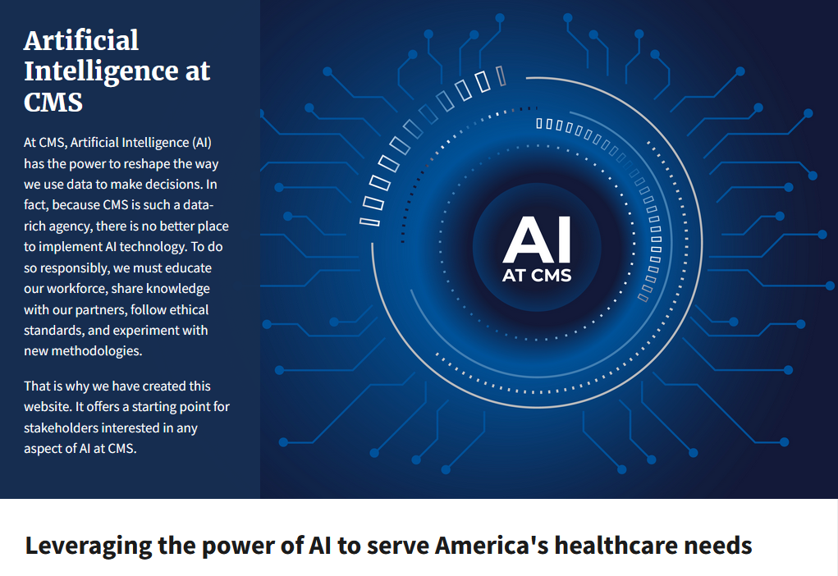
Answer (continued): In September 2024, when AMA released the 2025 CPT code set, AMA described ongoing updates to AI coding rubric (https://www.ama-assn.org/press-center/press-releases/ama-releases-cpt-2025-code-set):
Augmented/Artificial Intelligence (AI)
The AI Taxonomy introduced in 2023 has been implemented in category III CPT codes to classify AI medical services and procedures as assistive, augmentative, or autonomous based on the work performed by the AI application on behalf of the physician or other qualified health care professional (QHP). Seven category III code have been established for AI augmentative data analysis involved in electrocardiogram measurements (0902T and 0932T), medical chest imagining (0877T-0880T), and image-guided prostate biopsy (0898T).
While AMA oversees the CPT codes, the Centers for Medicare & Medicaid Services (CMS) is responsible for creating, maintaining and updating the HCPCS code set, including all AI-related HCPCS codes, and determining which AI-enabled services are covered under Medicare and Medicaid. CMS collaborates with the AMA and other stakeholders to assess the clinical validity, cost-effectiveness, and regulatory compliance of AI medical technologies, ensuring that AI-based CPT and HCPCS codes align with federal healthcare policies, reimbursement frameworks, and patient care standards. Quarterly updates to CPT codes are downloadable at: https://www.cms.gov/medicare/coding-billing/healthcare-common-procedure-system/quarterly-update . CMS has launched a new AI website which contains direct links to all CMS AI resources.
New CMS AI Website https://ai.cms.gov/

Slide 11

Answer (continued): CMS published a 102-page Artificial Intelligence Playbook. See: https://ai.cms.gov/assets/CMS_AI_Playbook.pdf
Which provides guidelines, best practices, and governance frameworks for the responsible implementation of AI within CMS. The Playbook highlights several issues involving AI models and health data including:
Data Quality and Availability – AI models rely on large volumes of high-quality, representative data. Issues like incomplete, biased, or unstructured data can lead to inaccurate predictions and inequitable outcomes.
Privacy and Security Risks – AI-driven healthcare applications must adhere to HIPAA, the Privacy Act, and other regulations, ensuring personal health information and personally identifiable information are protected from breaches and misuse.
Bias and Equity Concerns – AI systems can perpetuate disparities in healthcare if trained on biased datasets, requiring rigorous fairness assessments and mitigation strategies.
AI Transparency and Explainability – Ensuring that AI-driven decisions are understood and justified by clinicians, patients, and policymakers to ensure regulatory compliance.
Interoperability and Integration Challenges – AI applications must be designed to function across different CMS systems, healthcare providers, and payer networks while maintaining standardized data governance policies.
Ethical and Compliance Oversight – The need for governance frameworks to ensure AI models align with CMS policies, regulatory mandates, and ethical best practices.
Scalability and Sustainability of AI Models – AI projects must transition from pilot phases to fully operational, scalable solutions that can be maintained over time, considering factors like computational costs, infrastructure readiness, and evolving CMS needs.

Slide 12
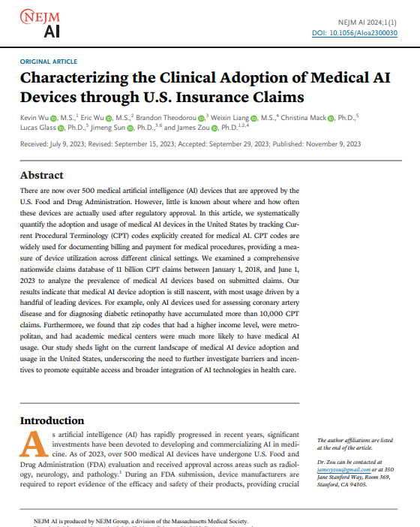
Answer (continued): Concerning the current use of AI coding, the inaugural issue of the New England Journal a Medicine’s new NEJM AI journal published, “Characterizing the Clinical Adoption of Medical AI Devices through U.S. Insurance Claims”. The investigators applied AI related CPT codes to the IQVIA PharMetricsVR Plus for MedTech dataset, a health plan database of medical and pharmacy claims of more than 210 million unique U.S. enrollees from largely commercial health plans. Downloadable at: https://ai.nejm.org/doi/pdf/10.1056/AIoa2300030 The key findings were:
Limited but Growing Adoption: Although over 500 medical AI devices have received FDA approval, real-world adoption remains limited, with only a few devices—such as those for coronary artery disease and diabetic retinopathy—accumulating over 10,000 CPT claims.
Geographic and Economic Disparities: AI medical devices are predominantly used in high-income, metropolitan areas and academic medical centers, highlighting disparities in access to AI-driven healthcare technologies.
Billing and Reimbursement Insights: The study systematically tracks AI-specific CPT codes to assess their usage in clinical practice, finding that most AI-related procedures are still emerging and that reimbursement mechanisms significantly influence adoption.
Variability in Pricing and Coverage: Medicare and private insurance show discrepancies in AI-related reimbursement rates, with private payers generally negotiating higher prices than CMS-set payment rates, reflecting ongoing uncertainty in AI valuation.
Challenges in AI Implementation: Beyond regulatory approval, AI adoption is hindered by clinical workflow integration, economic incentives, and physician interaction with AI outputs, suggesting that broader systemic changes are needed for widespread AI utilization in healthcare.

Slide 13
Answer (continued): The AI related procedure codes ('92229','0501T','0502T','0503T','0504T’, '0623T', '0624T', '0625T’, '0626T’, '0648T’, '0649T’, '0697T’, '0698T', '0689T', '0690T’, '0764T’, '0716T’, '0723T’, '0724T’, '0777T', '0721T', '0722T','0740T','0741T','0691T','0710T','0713T', '0731T', '0749T’) analyzed in the NEJM AI journal’s national study, “Characterizing the Clinical Adoption of Medical AI Devices through U.S. Insurance Claims” by Kevin Wu and his seven co-investigators at Stanford University and the University of Illinois Urbana-Champaign were utilized to determine their emergence in the MA APCD. In the MA APCD years 2021, 2022, and 2023, the procedure code ranking by claim volume matched the findings of national study for the top-ranking procedure code range of 0501T-504T for coronary artery disease. See Table below.
AI Codes in the
MA APCD
Summary of Select AI CPT Code Ranked by Claim Volume in MA APCD for Incurred Years 2021-2023
Claim Count | Procedure Codes | National Study Disease or Medical AI Procedure Description | CPT Description
4818 | 0501T–0504T | Coronary Artery Disease | Noninvasive estimated coronary fractional flow reserve derived from coronary computed tomography angiography data
1705 | 0689T–0690T | Breast Ultrasound | Quantitative ultrasound tissue characterization (non-elastographic)
1305 | 0648T–0649T | Liver MR | Quantitative magnetic resonance for analysis of tissue composition
175 | 92229 | Diabetic retinopathy | Imaging of retina for detection or monitoring of disease
137 | 0764T–0765T | ECG cardiac dysfunction | Assistive algorithmic electrocardiogram risk-based assessment for cardiac dysfunction
33 | 0623T–0626T | Coronary atherosclerosis | Automated quantification and characterization of coronary atherosclerotic plaque to assess severity of coronary disease
* | 0697T–0698T | Multiorgan MRI | Quantitative magnetic resonance for analysis of tissue composition
* | 0723T–0724T | Quantitative MR cholangiopancreatography | Quantitative magnetic resonance cholangiopancreatography
* | 0777T | Epidural infusion | Real-time pressure-sensing epidural guidance system

Slide 14
AI Codes in the
MA APCD
Answer (continued): . While imaging for diabetic retinopathy ranked second in the national study, breast ultrasound ranked second in the MA APCD. The growth of medical AI in CPT codes in the MA APCD mirrored the upward linear trend in the national study from year 2021 through year 2023.
MA APCD Increase in Monthly Medical Claim Line for CPT AI Procedures for Incurred Years 2021-2023

Slide 15

Question: I am currently using the MA APCD, specifically in years 2019-2022, to conduct behavioral health care transition analysis and am finding a significant number of member link EIDs (MEIDs) missing for OrgID 10187, an OrgID not listed on the Master Patient Index exclusion report. What is the relationship between this OrgID and MassHealth? Is there a resolution to the missing MEIDs?
Member Link EIDs for
Care Transitions
Answer: Yes, these MEIDs are not missing. They are there. OrgId 10187 is Massachusetts Behavioral Health Partnership (MBHP) which is a managed behavioral health organization that administers behavioral health services for MassHealth (OrgId 3156), the Massachusetts' Medicaid program. MBHP oversees and coordinates mental health and substance use disorder services for individuals enrolled in certain MassHealth plans, including those in the Primary Care Clinician (PCC) Plan and other eligible managed care plans. Since the restructuring of MassHealth into an Accountable Care Organization (ACO) and Managed Care Organization (MCO) model, MBHP primarily serves MassHealth members who are not enrolled in ACOs with their own behavioral health administrators. Therefore, MBHP does not serve all MassHealth members but plays a crucial role in managing behavioral health for those in specific MassHealth programs.
All the MEIDs for MHBP (OrgId 10187) beneficiaries in the claims database can be obtained through linkage to the member eligibility table under MassHealth (OrgId 3156).
In the medical claims database, yes, there is a field called OrgID where you see the value ‘10187’. However, every record which has that value in the OrgID field has the value ‘3156’ for MassHealth in a second field called linkorgidme.

Slide 16
Answer (continued): As shown below, if you ran a query of orgid and linkorgidme, you would see
that the linkorgidme associated with orgid 10187 is 3156 as shown below.
QUERY: SELECT t.orgid ,t.linkorgidme
FROM cy2021.tbl_medicalclaim t
WHERE t.orgid = 10187
LIMIT 5;
RESULTS:
orgid linkorgidme
10187 3156
10187 3156
10187 3156
10187 3156
10187 3156
As shown below, link medical claims to member eligibility table using two fields: chiacarrierspecificuniquememberid (CSUMID) in medical claims links to CSUMID in the member eligibility table. However, instead of also using orgid from the medical claims for linkage, use linkorgidme in medical claims to link to orgid in the member eligibility table. This approach ensures that you obtain the MEIDs for members under orgid 10187, which were generated based on MassHealth demographic data. Note that in the results below, the actual memberlinkeids have been masked.
QUERY: SELECT t.orgid, t.linkorgidme, m.memberlinkeid
FROM cy2021.tbl_medicalclaim t
INNER JOIN cy2021.tbl_membereligibility m
ON t.linkorgidme = m.orgid AND t.chiacarrierspecificuniquememberid = m.chiacarrierspecificuniquememberid
WHERE t.orgid = 10187
LIMIT 5;
RESULTS:
orgid linkorgidme memberlinkeid
10187 3156 6XXXXX
10187 3156 8XXXXX
10187 3156 4XXXXX
10187 3156 6XXXXX
10187 3156 6XXXXX
Member Link EIDs for
Care Transitions

Slide 17

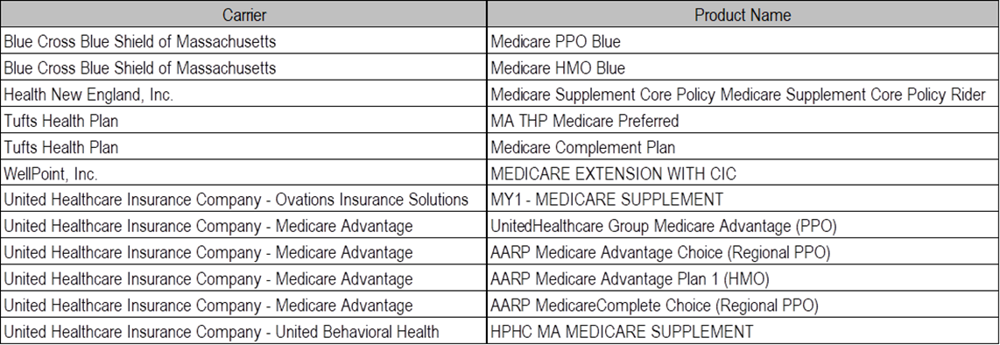
Question: I am using the FY2021-2023 Hospital Inpatient Discharge Data and am unclear on what is encompassed under Payer Source Code 134, Medicare HMO - Other (not listed elsewhere). I would appreciate any information you can share.
Payer Source
Codes
Answer: In the case mix data, Payer Source Code ‘134’ serves as an aggregate classification encompassing a vast
array of Medicare HMO products, numbering in the several thousands. These products, along with their associated
benefits, are subject to continual flux, with frequent modifications and updates. To provide an example (see table below),
CHIA linked case mix records containing Payer Source Code ‘134’ to the MA APCD and below are just a few examples
of the corresponding MA APCD product details associated with patients with Payer Source Code ‘134’.
The case mix payer source codes function as broad categorical designations, strategically structured to streamline administrative processes and prevent delays in the timely dissemination of case mix datasets without the concurrent requirement of ensuring granular look-up table definitions governing thousands and thousands of individual insurance products are continuously updated to reflect ongoing changes. Researchers and analysts requiring a more granular examination of product-level distinctions are encouraged to apply for the MA APCD for comprehensive data analysis which does capture the ongoing product churning in specific detail.
Examples of Medicare HMO Products

Slide 18
When is the next Data User Group meeting?
  The next User Group will meet Tuesday, March 25, 2025.
  http://www.chiamass.gov/ma-apcd-and-case-mix-user-workgroup-information/

Slide 19
Questions?
Questions related to MA APCD email:
apcd.data@chiamass.gov
Questions related to Case Mix email:
casemix.data@chiamass.gov
REMINDER
CHIA still receives a high volume of email from data users who do not include their IRBNet ID. If you are in the process of or have already submitted a data application to CHIA through IRBNet https://www.irbnet.org/release/home.html, due to the volume of email CHIA receives, please remember to always include your IRBNET ID# in the subject line of your email. Doing so facilitates tracking your application and expediting responses to any questions.

