Slide 1
CHIA Data User Workgroup
Donald Kirkwood, Manager of Data Release and Procurement
Scott Curley, Chief Data Product Officer
Anne Medinus, Senior Research Account Specialist
Sylvia Hobbs, Associate Director of Data Strategy and User Support
March 28, 2025

Slide 2
Agenda
Announcements:
  All FY2023 Case Mix Releases and FY2024 HIDD
  Certificate of Continued Need and Compliance
  MA APCD CY2023 Now Available for Request
  CHIA’s YouTube Video Training on Data Use Obligations
  NEJM AI Launches Grand Rounds Podcasts
  New publication using the MA APCD
Data User Support Questions
  Health Care Facility Bed Counts
  Designating External Linkage Fields
  MA APCD Currency Fields
  Interfacility Transfers Revisited
Q&A

Slide 3
Announcements

Slide 4
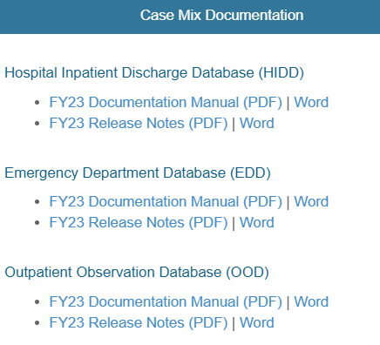
FY2023 Case Mix Releases and Documentation
ALL FY2023 CASE MIX RELEASES ARE AVAILABLE
Before accessing the FY2023, review the case mix documentation and release notes. The documentation contains a data overview, including data element list, data dictionary, reference tables, and summary statistics. The release notes contain information directly submitted by hospitals explaining data anomalies. Remember to review documentation and release notes before accessing data.
Documentation and Release notes available at
https://chiamass.gov/case-mix-data
The Projected Data Release Schedule for
FY2024 Hospital Inpatient Discharge Data is June 2025

Slide 5
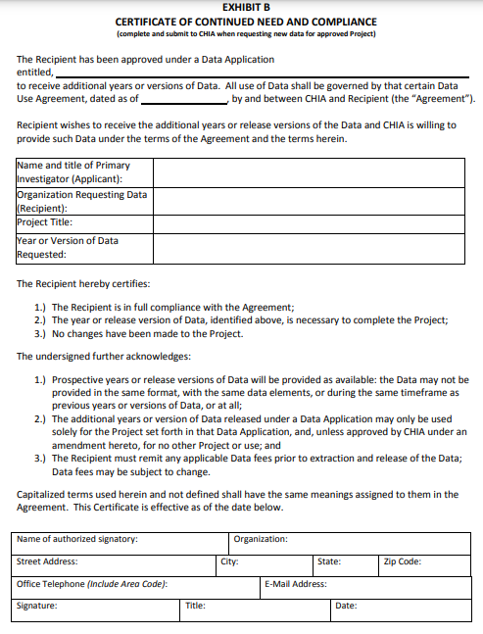
CERTIFICATE OF CONTINUED NEED AND COMPLIANCE
Exhibit B
Page 10 of the Data Use Agreement
Those with approved projects using previous data who a new year’s data should submit an Exhibit B (Certificate of Continued Need and Compliance) of page 10 the Data Use Agreement. Afterwards, you will receive an invoice (if applicable). Upon payment, the order for the new year of data will be placed.

Slide 6

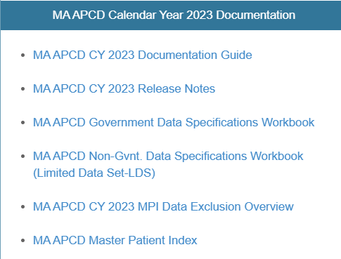
MA APCD CY2023 Now Available
CY2023 MA APCD is now available and includes medical, pharmacy and dental claims incurred between January 1, 2019, and December 31, 2023. It includes a six months of run-out (paid claims through June 30, 2024). In addition to claims data, the release includes associated member eligibility, providers, products, and benefit plans. Applicants already approved for MA APCD CY2022 who require CY2023 should, as mentioned previously, submit to CHIA a completed Exhibit B (Certificate of Continued Need and Compliance) of the DUA. Afterwards, you will receive an invoice (if applicable) for the requested data. Upon payment of the invoice the order for the data will be placed. As with case mix data, before accessing the MA APCD remember to review documentation on the releases available at: https://www.chiamass.gov/ma-apcd/
Documentation and Release notes available at
https://chiamass.gov/ma-apcd
Before accessing the CY2023 MA APCD, review the documentation guide and release notes for important highlights and updates to the data. For example, in this release, CHIA’s substance use disorder filter was updated to include fourteen new codes within the ranges in the 2018 CMS SUD filter.

Slide 7
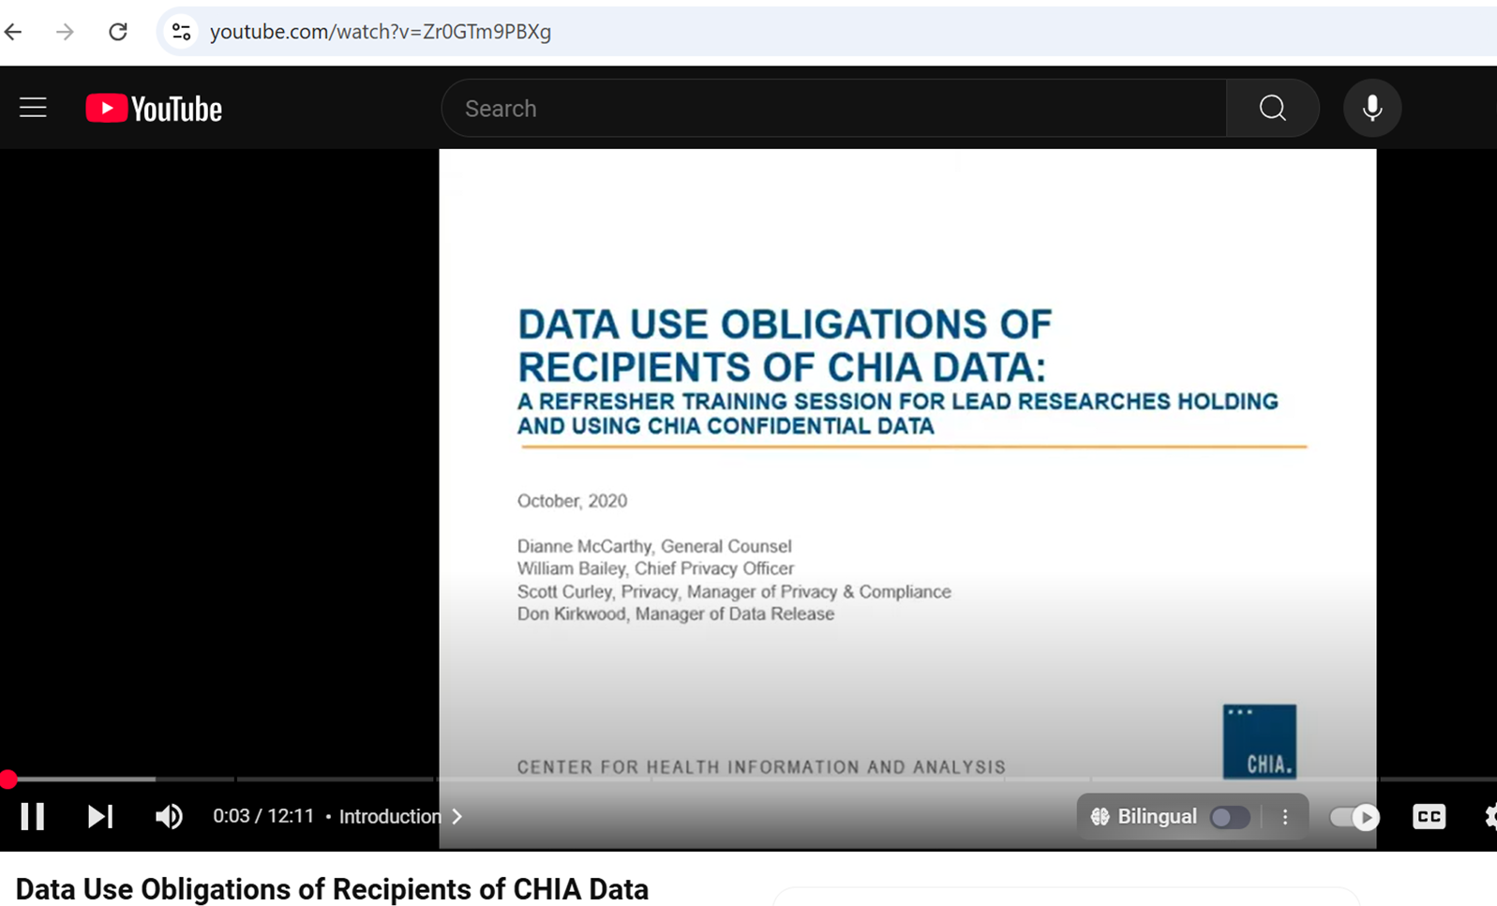
CHIA’s YouTube Channel
Data users should review CHIA’s short 12-minute YouTube video by CHIA’s Legal Unit on the Data Use Obligations of Recipients of CHIA Data: A Refresher Training Session for Lead Researchers Holding and Using CHIA Confidential Data at: https://www.youtube.com/watch?v=Zr0GTm9PBXg

Slide 8



Alert: Massachusetts Medical Society’s NEJM AI Launches Grand Rounds Podcasts
NEJM AI Launches Grand Rounds Podcasts
    https://ai-podcast.nejm.org/
NEJM AI new Grand Rounds Podcasts, hosted by Dr. Arjun Manrai and Dr. Andrew Beam, features informal conversations with a variety of unique experts exploring the deep issues at the intersection of artificial intelligence, machine learning, and medicine. Available on Apple Podcast, Spotify, or YouTube. You’ll learn how AI will change clinical practice and healthcare, how it will impact the patient experience, and about the people who are pushing for innovation. Whether you are an AI researcher or a practicing clinician, these conversations will enlighten and surprise you as we journey through this very exciting field. Produced by NEJM Group.

Slide 9
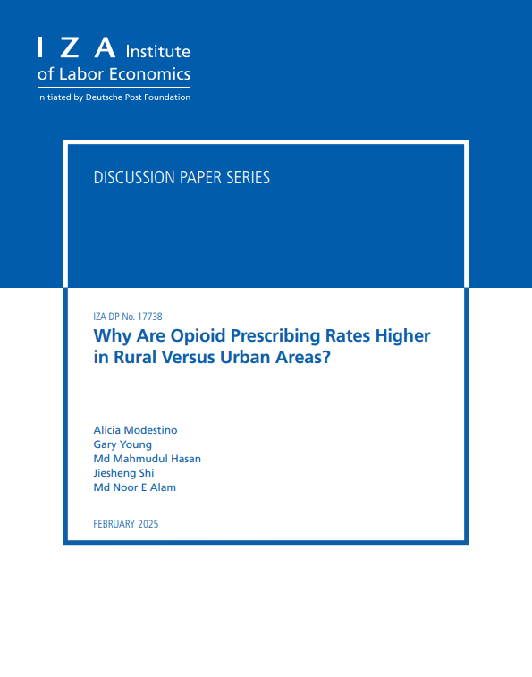
Alert: New Publication using the Massachusetts All Payer Claims Data
Why Are Opioid Prescribing Rates Higher in Rural Versus Urban Areas?
by Alicia Modestino, Gary Young, Mahmudul Hasan, Jiesheng Shi, Noor E Alam
https://docs.iza.org/dp17738.pdf
A new paper published February 2025 entitled "Why Are Opioid Prescribing Rates Higher in Rural Versus Urban Areas?" investigates the persistent disparity in opioid prescribing rates between rural (non-metropolitan) and urban (metropolitan) areas using Massachusetts All-Payer Claims Data from 2010–2014.
The authors find that patients in rural areas are 10 percent more likely to receive an opioid prescription. About half of this gap is due to the underlying health status of rural populations, such as higher rates of chronic pain conditions and disabilities.
A detailed Blinder-Oaxaca decomposition breaking down the differences in outcomes between groups shows that most of the remaining disparity is driven by demand-side factors like insurance type and veteran status, and supply-side factors such as limited access to alternative pain treatments and the predominance of general practitioners over specialists.
When both demand and supply-side variables and their interactions (e.g., physically demanding jobs and healthcare system characteristics) are considered, the gap effectively disappears. The study highlights that policy solutions to reduce excessive opioid prescribing should be context-specific, accounting for local economic and healthcare system conditions rather than relying on one-size-fits-all interventions.

Slide 10
Data User Support Questions

Slide 11

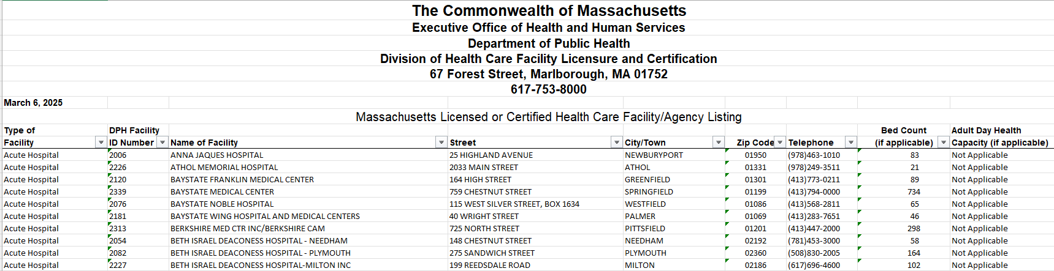
Question: I am using the MA APCD to analyze occupancy rates and determine to what extent Massachusetts hospitals are operating at or over capacity. In addition, I am benchmarking length of stay to determine if a hospital discharges more patients than its beds suggest it can handle. What would be the best source of health care facility bed counts?
Health Care Facility
Bed Counts
Answer: The Massachusetts Department of Public Health’s Bureau of Health Care Safety and Quality provides information on health care facilities that it licenses or certifies through the Division of Health Care Facility Licensure on their website at the link below which has a downloadable spreadsheet containing bed capacity data as of March 6, 2025. A screenshot below previews the included data fields.
https://www.mass.gov/info-details/find-information-about-licensed-or-certified-health-care-facilities

Slide 12

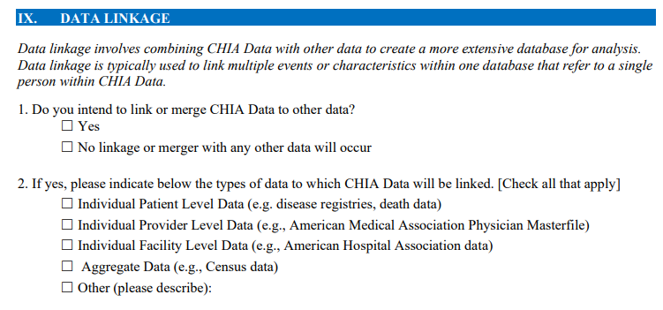

Question: I recently applied for access to the Massachusetts All-Payer Claims Database (MA APCD) and was informed that the submission was deemed incomplete due to insufficient detail regarding external data linkage. While I did specify the type of external dataset to which the MA APCD would be linked, I would appreciate further clarification on the specific information or documentation required to satisfy this criterion.
External Data
Linkage
Answer: This a frequently encountered omission among data applicants. Within the Data Linkage section of the application (page 6), applicants who select “Yes” in response to Question 1, indicating their intention to link or integrate CHIA data with external datasets, and who identify the external data type in Question 2, must also address Question 5 on page 7. Specifically, they are required to either upload or include a comprehensive list of all variables from each data source that will be incorporated into the final linked analytic dataset. This information is essential for CHIA to verify that no identifiers or quasi-identifiers previously removed through the de-identification process are inadvertently reintroduced via linkage. Below is an illustrative example of the level of detail expected, using the American Medical Association Physician Masterfile as the external dataset selected in Question 2.
External Data from American Medical Association Physician Masterfile
License expiration date
Primary Specialty
Board Certification Status
Type of Practice
Group Affiliation
Hospital Affiliation
Languages Spoken
Medical School Name
Degree Earned

Slide 13

Question: I typically the use the case mix hospital inpatient discharge data (HIDD) to analyze hospital charges from the facility provider’s perspective. I am considering applying for the MA APCD to analyze by hospital the magnitude of decrease in the payer’s adjudicated amounts across hospitals, including getting a better understanding of patient cost-sharing and coordination of benefits. What is the between the difference between the currency fields between HIDD and the MA APCD?
Currency
Data Fields
Answer: The HIDD currency data is limited to charges which represent hospital’s valuation for rendered medical services and utilization. In HIDD that information is captured in three tables (see below). The main discharge table has four fields stratifying charges by total routine, total special, total ancillary, and total all for each individual patient discharged. The submission log table has total charges aggregated by hospital for each submission period, and services table has total charges stratified for each patient for each distinct revenue code.
Hospital Inpatient Discharge Data Currency Fields
Main Discharge Table: Charges by Individual Patient Submission Log: Charges by Hospital Service Table: Charges by Revenue Code
FIELD | DESCRIPTION
Total Charges Routine | Charges related to routine daily services — standard room & board, nursing care, meals, etc. Typically tied to routine inpatient stays without needing specialized equipment or services.
TotalChargeSpecial | Charges for specialized services — think ICU, CCU, step-down units, or other non-routine care. Higher acuity areas fall here.
TotalChargesAncillaries | Charges for ancillary services — labs, radiology, pharmacy, physical therapy, respiratory therapy, etc. These support diagnosis and treatment beyond bed and board
TotalChargesAll | The total of all charges — usually equals Routine + Special + Ancillaries + Other.
Field | DESCRIPTION
TotalChargesAll | The total of all charges — usually equals Routine + Special + Ancillaries + Other.
Field | DESCRIPTION
TotalCharges | Charges by distinct Revenue Codes

Slide 14
Currency
Data Fields
Answer (continued): The MA APCD medical claims contains 15 currency fields (see table below). Compared to HIDD, the MA APCD currency fields enable more granular financial analysis of healthcare transactions, e.g., analysis of the distinction between billed charges, negotiated payments, patient financial burden across different payer structures, and cost-sharing dynamics.
MA APCD Medical Claims Currency Fields
Field | Description
ChargeAmount | Total amount billed by the provider for a service, not necessarily what’s paid.
PaidAmount | Total amount paid by the insurer or payer for the claim line or service.
PrepaidAmount | Amount paid before the service was rendered, e.g., capitation or pre-authorized payment.
CopayAmount | Fixed amount the patient is required to pay for a service, typically due at the time of service.
CoinsuranceAmount | Percentage-based cost-sharing amount the patient owes, calculated as a percent of allowed charges.
DeductibleAmount | Amount the patient owes because their deductible hasn’t been met, the part they pay out-of-pocket before insurance kicks in.
CoordinationOfBenefitsTPLLiabilityAmount | Amount assigned to another payer under Coordination of Benefits (COB) or Third-Party Liability (TPL), e.g., auto insurer, workers’ comp, or secondary health plan.
OtherInsurancePaidAmount | Amount actually paid by a secondary or tertiary insurer.
MedicarePaidAmount | Specific field showing what Medicare paid if it was the primary or secondary payer.
AllowedAmount | Maximum amount the insurer agrees to consider for payment (i.e., Paid + Patient Responsibility). Often lower than Charge Amount.
NonCoveredAmount | Amount denied due to policy exclusions, services not covered under the plan.
ExcludedExpenses | Charges that are not payable under the plan and not applied to patient responsibility , could be administrative or policy-related exclusions.
WithholdAmount | Amount temporarily withheld from payment, often used in capitation, risk-sharing, or performance-based contracts.
ValueCodeAmount | The dollar amount corresponding to ValueCode (Not always currency data)
PatientTotalOutOfPocketAmount | Sum of copay + coinsurance + deductible + other non-covered amounts the patient is responsible for ,sometimes tracked to monitor ACA out-of-pocket maximums.

Slide 15

Question: How are patients categorized who initially present to an outpatient emergency department but are subsequently escalated to a 24-hour level of care setting, such as Acute Treatment Services (ATS) or Community Crisis Stabilization (CCS)? Specifically, is their discharge disposition typically recorded as a “transfer to another facility,” or is it classified under “routine discharge”?
Interfacility
Transfers
Answer: Hospitals classify a patient as an interfacility transfer when the individual is transitioned directly, without interruption, from one licensed facility to another with 24-hour beds, utilizing a licensed medical transport service, whether emergent (e.g., ground or air ambulance) or non-emergent (e.g., stretcher van, wheelchair van).
Specifically, an interfacility transfer encompasses a continuous and structured chain-of-custody protocol that preserves medical accountability for the patient’s identity, clinical trajectory, and therapeutic plan throughout the handoff. At no point should clinical oversight lapse; the responsibility for patient care must remain clearly designated from the time of departure at the sending facility to the moment of arrival at the receiving institution. This process involves a formal clinical handoff, which includes a comprehensive transfer packet comprising documentation such as the current clinical summary, which could include relevant medical history, active medication lists, diagnostic imaging, laboratory data, insurance details, and any applicable authorizations or advance directives. This protocol not only ensures medical continuity but also satisfies standards related to interfacility coordination of care.
However, when a patient departs the emergency department independently and subsequently seeks care at a different site, the encounter is typically recorded as a routine discharge, as the chain of clinical custody has been disrupted, and no formal transfer of responsibility or medical oversight has occurred.

Slide 16
When is the next Data User Group meeting?
  The next User Group will meet Tuesday, April 22, 2025.
  http://www.chiamass.gov/ma-apcd-and-case-mix-user-workgroup-information/

Slide 17
Questions?
Questions related to MA APCD email:
apcd.data@chiamass.gov
Questions related to Case Mix email:
casemix.data@chiamass.gov
REMINDER
CHIA still receives a high volume of email from data users who do not include their IRBNet ID. If you are in the process of or have already submitted a data application to CHIA through IRBNet https://www.irbnet.org/release/home.html, due to the volume of email CHIA receives, please remember to always include your IRBNET ID# in the subject line of your email. Doing so facilitates tracking your application and expediting responses to any questions.

