Slide 1
FY 2026 Case Mix Updates Webinar
April 24, 2025

Slide 2
Agenda
Welcome
FY 2026 OOD Submission Guide Updates
Timeline / Next Steps
Questions & Comments

Slide 3
Changes & Revisions
For
outpatient observation DATA

Slide 4
Submission Guide Changes - OOD
Key Changes: File Format | File Type
NEW! Asterisk Delimiter Format | OOD
NEW! Add Header Record (first record in the file; only one per file) | OOD
Key Changes: New Fields | File Type
Provider Organization Id (Header Record, Field 1) | OOD
Hospital Name (Header Record, Field 2) | OOD
Period Starting Date (Header Record, Field 3) | OOD
Period Ending Date (Header Record, Field 4) | OOD
Number of Outpatient Observation Stays (Header Record, Field 5) | OOD
Total Charges (Header Record, Field 6) | OOD
National Provider Identifier (NPI): Surgeon (Visit Record, Field 104) | OOD
National Provider Identifier (NPI): Attending Physician or Clinician (Visit Record, Field 105) | OOD
National Provider Identifier (NPI): Additional Caregiver (Visit Record, Field 106) | OOD

Slide 5
Timeline / Next Steps:
FY26 Case Mix Intake Process | Draft Timeline
Provider Comment Period Ends | May 9, 2025
Administrative Bulletin and Guides Adopted | May 2025
CHIA and Hospitals Update Systems | June – December 2025
Hospital Testing Period | Dec 2025 – January 2026
Quarter 1 Submission (Oct – Dec) Preliminary Data Files Final Data Files | January 31, 2026 March 16, 2026

Slide 6
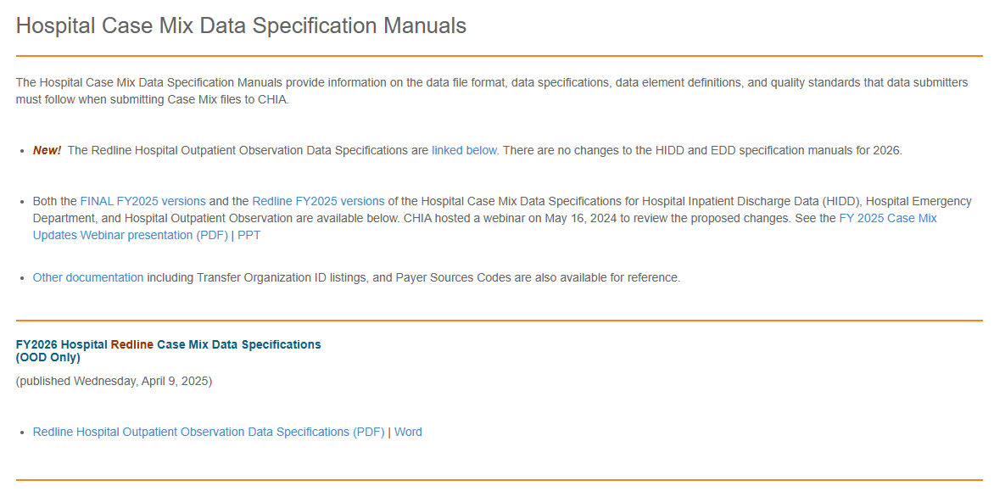
Submission Guides – Published to CHIA Website http://www.chiamass.gov/hospital-data-specification-manuals/

Slide 7
Questions & Comments

Slide 8
Follow-up Contacts
Cathy Houston, Associate Director of Hospital Data Intake & Compliance Catherine.Houston@CHIAMass.gov
Linda Stiller, Manager, Data Intake and Compliance Linda.Stiller@CHIAMass.gov
Hospital Liaisons:
Hadish Gebremedhin, Senior Health Care Data Liaison Hadish.Gebremedhin@CHIAMass.gov
Jillian Petrie, Health Care Data Liaison
Jillian.Petrie@CHIAMass.gov
Hospital Email: HospitalData@CHIAMass.gov

